Slide 1
NEW VERSION OF THE ESA SEU MONITOR
François-Xavier Guerre
Hirex Engineering
ESA contract 13528-99-NL-MV COO 22-1 + CCN2

Slide 2
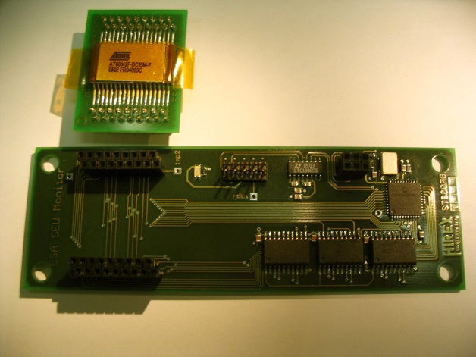
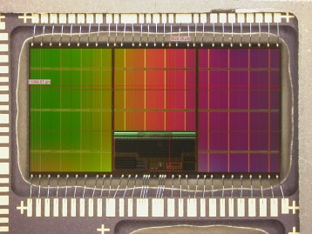
Mother board (STB007B) = 127mm x 42.2mm
Daughter board (STB014A) = 39mm x 30.8mm
First version of SEU monitor in 2005
Memory part used:
ATMEL AT60142F 4Mbit SRAM
Die area ~ 11mm*6mm
Link to PC via RS232/RS485

Slide 3
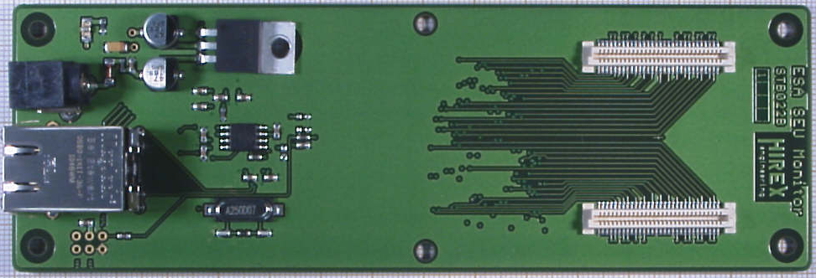
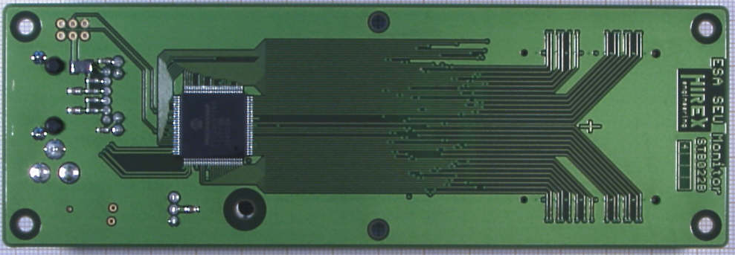
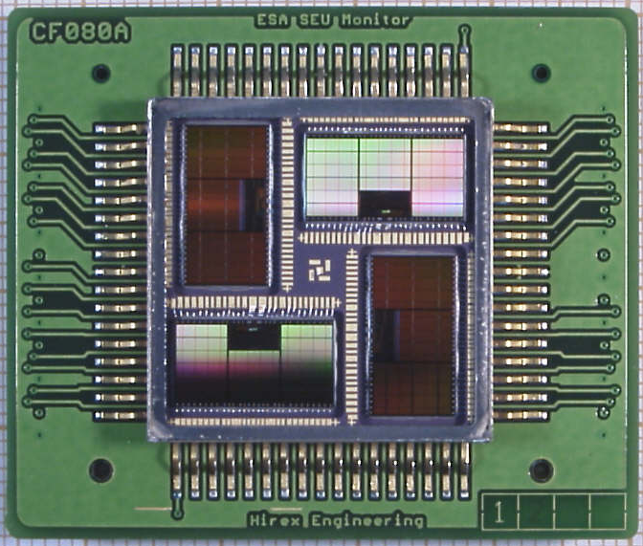
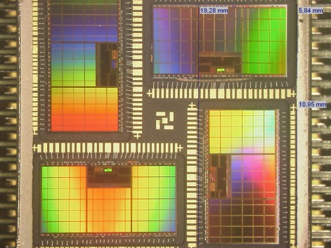
Ethernet plug
power jack
Mother board (STB022B) = 155mm x 52mm
Daughter board (CF080A) = 45mm x 38mm
New version of SEU monitor
developped in 2009
Memory device used:
4 die module
ATMEL AT60166F 16Mbit SRAM
Overall 4 Die area:
~ 19.5mm*19.5mm
Link to PC via Ethernet cable

Slide 4
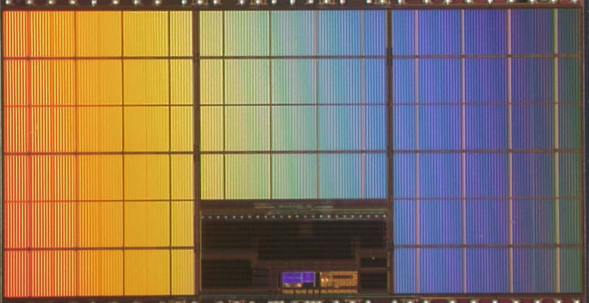
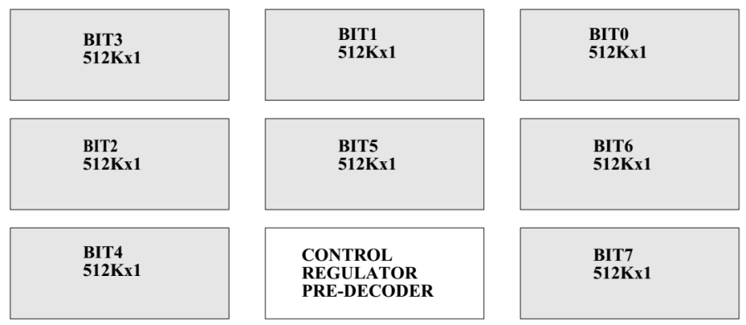
Bank 0
Bank 1
Bank 2
Bank 3
Bank 4
Bank 5
Bank 6
Bank 7
Bank 8
Bank 9
Bank 10
Bank 11
Bank 12
Bank 13
Bank 14
Bank 15

Slide 5
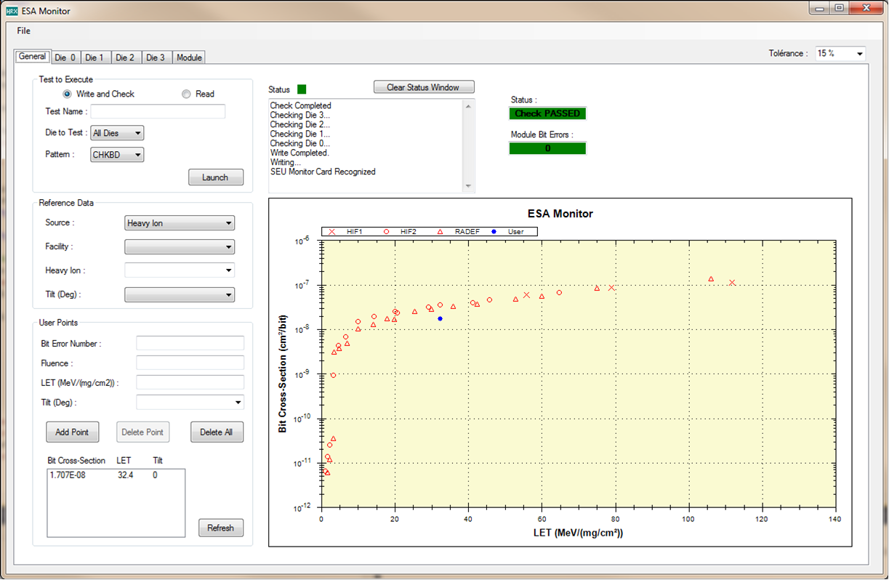

Slide 6
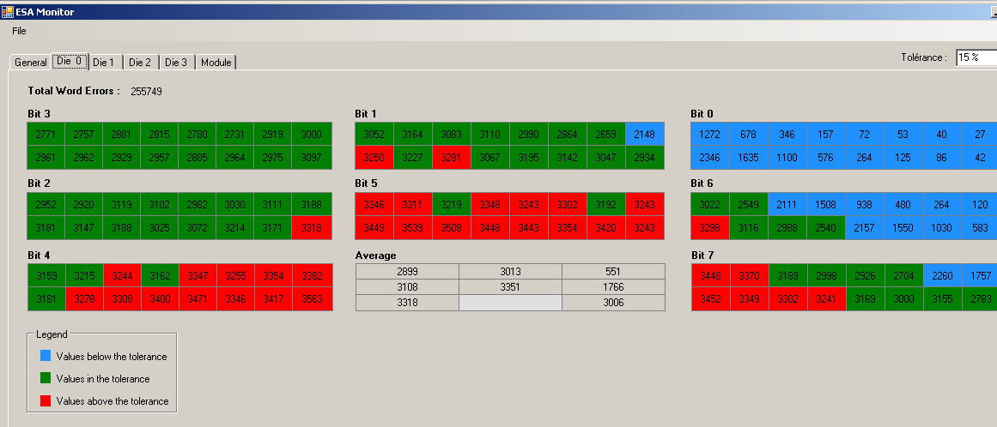

Slide 7
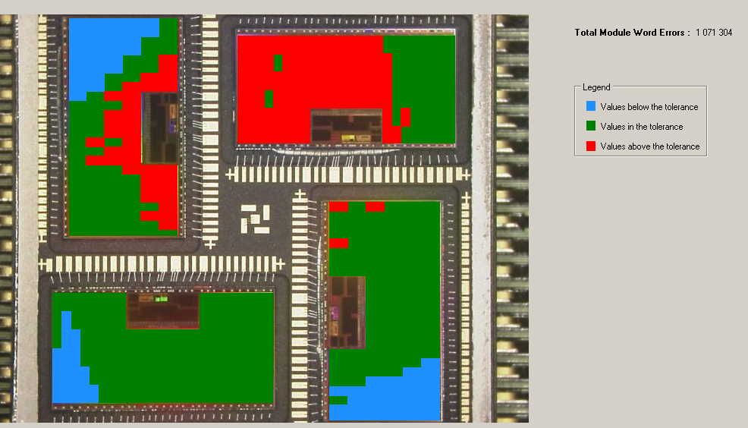
Die 0
Die 2
Die 3
Die 1

Slide 11
CONCLUSION
This monitor allows for beam fluence check at a given LET
Provides a SEU event distribution using 128*4 zones on an overall 4 die area of about19.5*19.5 mm²
22 SEU monitor sets have been delivered to ESA

