Slide 1
Calibration of RADFETs for the Component Technology Test-Bed (CTTB) of the Alphasat spacecraft radiation Environment and Effects Facility (AEEF)
ESA/1-6403/10/NL/SFe
Patrícia Gonçalves, Ana Keating, Andreia Trindade, Pedro Rodrigues, Miguel Ferreira, Pedro Assis, Michele Muschitiello, Bob Nickson, Christian Poivey
ESA-CNES Final Presentation Days, June 2013

Slide 2
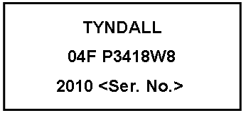
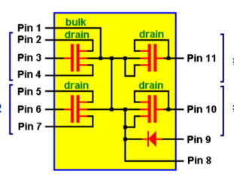
Test campaign
Study of the variation of the RADFET voltage threshold shift, ΔV_{th} as function of the dose, for different temperatures, and assessment of long-term annealing effects.
Characterization of 18* RADFET 02-400nm IMPL units, manufactured by Tyndall National Institute (Ireland).
Production batch of the flight lot to be assembled in the boards of the CTTB of the ALPHASAT spacecraft radiation Environment and Effects Facility (AEEF)
Each ESAPMOS4 RADFET package contains 4 RADFETS:
R#1 : 300/50 standard
R#2: 690/15 standard
R#3 : 300/50 passivated
R#4: 690/15 passivated
RF0
RF2
RF1
RF3
* 20 packages in the batch: 1 malfunctioning /1 kept for reference

Slide 3
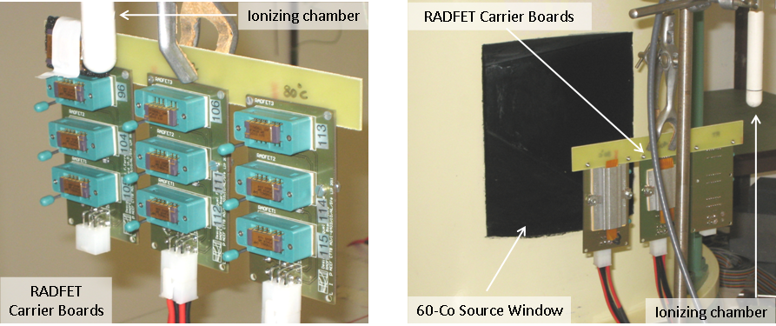
RADFET Carrier Boards
dedicated board developed and produced at LIP to provide a stable thermal environment.
guarantee that a packages are correctly grounded
3 RADFET packages/board at a specific temperature by means of a self-regulated PTC heater (20W/60ºC and 30W/80ºC)
2 PT100 Class B Thin Film Temperature sensors to monitor temperature during the irradiation
A dedicated RADFET read-out system from Tyndall National Institute, Ireland was used for measurements.

Slide 4
Irradiation
The RADFETS were irradiated at the ESA/ESTEC Cobalt-60 facility, up to ~50 krad.*
HDR : High Dose Rate
5 krad/hour : total 50 krad (H2O)
10 hours: 19 April 2011
LDR: Low Dose Rate
0.036 krad/hour : total 58 krad (H2O)
63 days: 20 April - 22 June 2011
25
60
80
25
60
80
25
60
80
25
60
80
25
60
80
25
60
80
25
reference
Procedure:
In 10 krad irradiation steps, the threshold voltage of each the RADFET was measured by applying a constant current of 10 μA and measuring the source-drain voltage.
* In Water ( converted to SiO2 in the analysis)

Slide 5
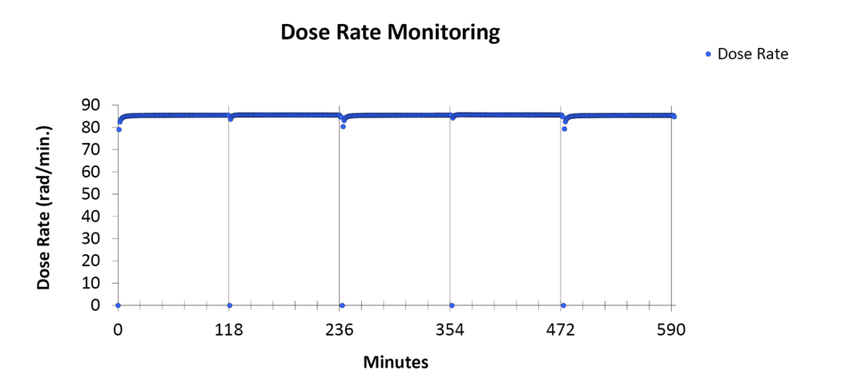
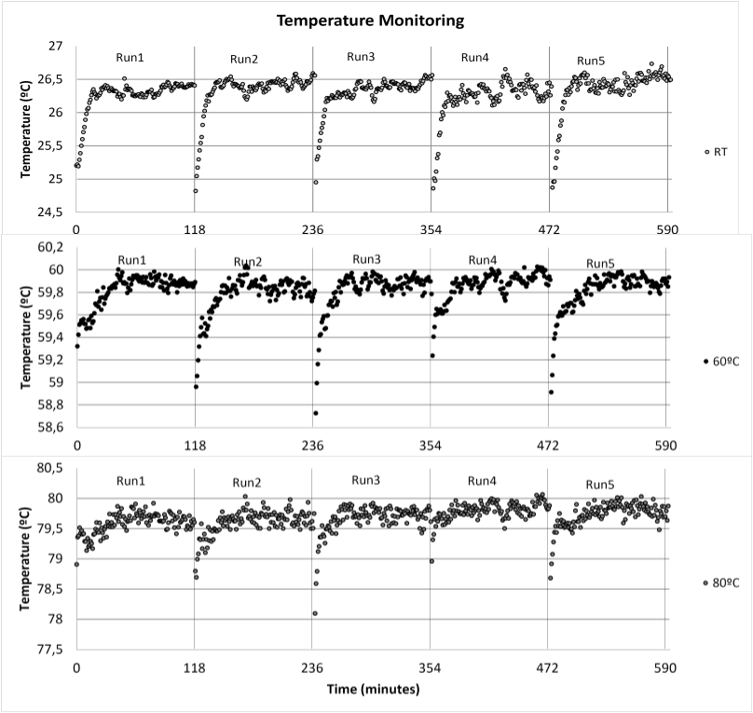
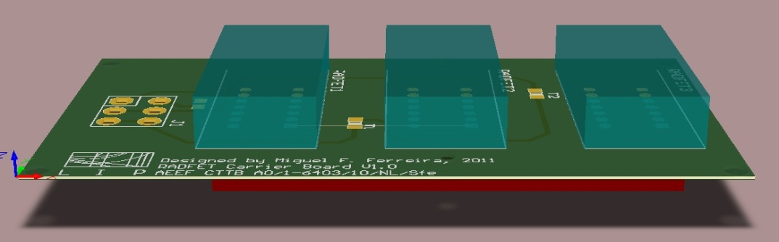
Thermal control
Example for HDR
5 runs of 2 hours each.
The temperatures were stabilized at 26.3 ±0.3ºC , 59.8 ± 0.2ºC , 79.9 ± 0.2ºC
the thermal heaters in the RADFET carrier boards are stable with ΔT ~ 0.2ºC
with the exception of the first minutes at the start of the runs for which the RADFET packages returned from the measurement setup ans were plavcd o the board.
maximum shift of the temperature of the board ~ 1ºC.

Slide 6
Irradiation Data Analysis
The voltage threshold shift is calculated with respect to the threshold voltage reference values measured before irradiation.
Data and preliminary analysis presented at :
Advances on Plasma and Rtadiation Workshop ESTEC, May 2012
RADECS 2012 Data Workshop (poster DW 19)
For HDR irradiation no temperature dependence was observed ,
but LDR irradiation data display temperature dependence
Analysis Procedure:
Fits of average of vs. Dose (SiO2) for 4 types of RADFET and for the 3 temperatures
Dose in SiO2 was used (measured dose H2O converted to SiO2)
Error on dose : 4.2% (from facility)
Error on Vths: taken from RMS of measurements of the reference RADFET (1%)

Slide 7
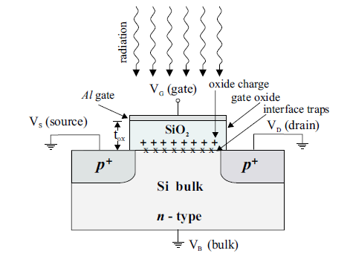
Models for the RADFET calibration ^{(*)}
,
.
interface trapped charge response
Credits to G. Ristic
oxide-trapped charge response
Conversion coefficient :
build-up of interface states <–hole annealing
5 free Parameters
^{(*)} F.B. McLean, “Generic Impulse Response Function for MOS Systems and its Applications to Linear Response Analysis”, IEEE Trans. Nucl. Sci., Vol. 35, No. 6, 1988
V.S. Pershenkov et al. “Three-Point Method of Predicion of MOS device Response in Space Environments”, IEEE Trans. Nucl. Sci., Vol. 40, No. 6, 1993.
K. F. Galloway, M. Gaitan and T. J. Russell, “A Simple Model for Separating Interface and Oxide Charge Effects in MOS device Characteristics”, IEEE Trans. Nucl. Sci., Vol. NS-31, No. 6, 1984
Y. H. Shin et. al, “Analysis of Anomalous TDE Data on-board the KITSAT-1”, IEEE Trans. Nucl. Sci., Vol. 46, No. 6, 1999

Slide 8
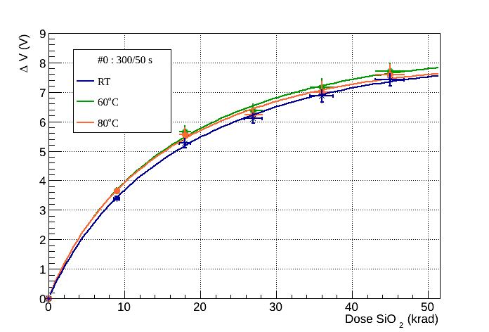
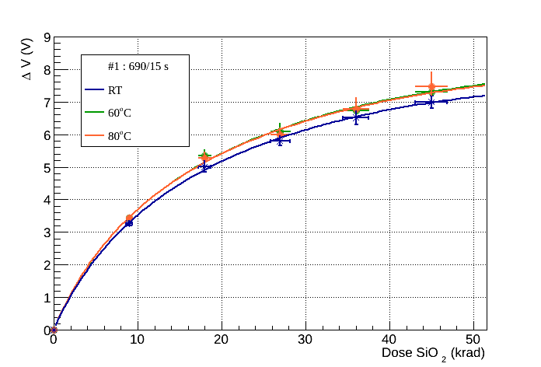
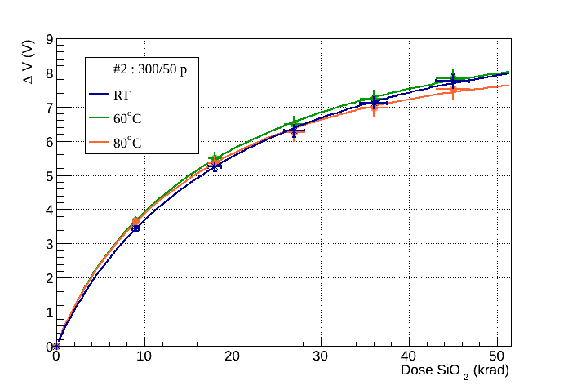
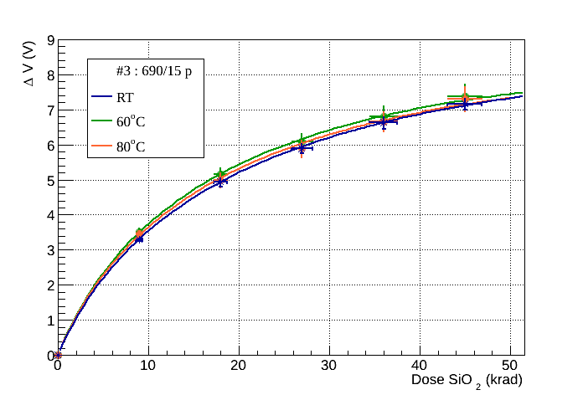
HDR irradiation
Up to 45 krad (SiO2) for γ = 4.5 krad(SiO2)/h ~ 10h irradiation
No temperature dependence is observed
Only fast response due to interface trapped states considered
RF0
RF2
RF1
RF3

Slide 9
LDR fit Method
Temperature dependence observed ΔV_{th} vs Dose for LDR irradiation data!
average values for each RADFET type from fits to HDR data used as fixed parameters in LDR fits
LDR fits with 2 free parameters
Coefficient for slow component for interface trapped charge build-up.
Independent of T

Slide 10
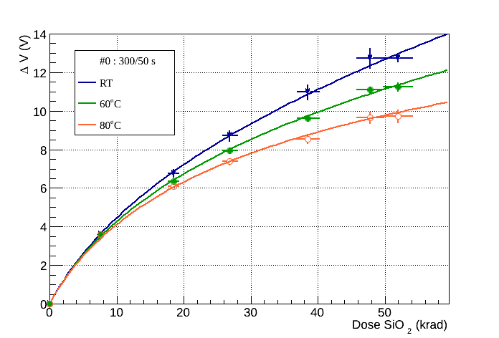
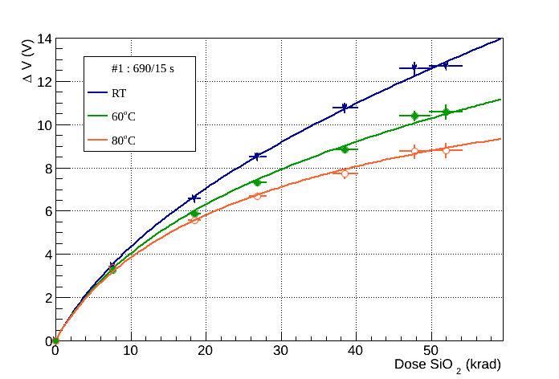
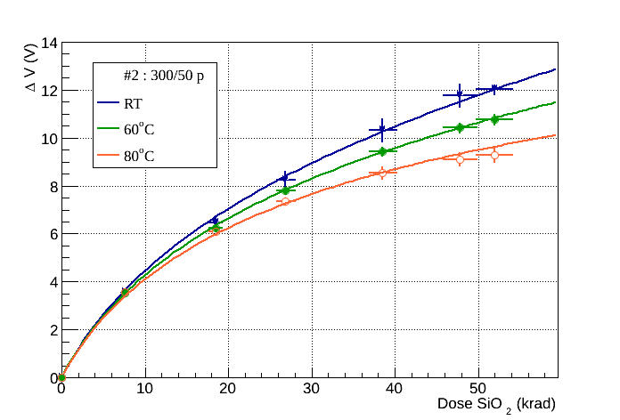
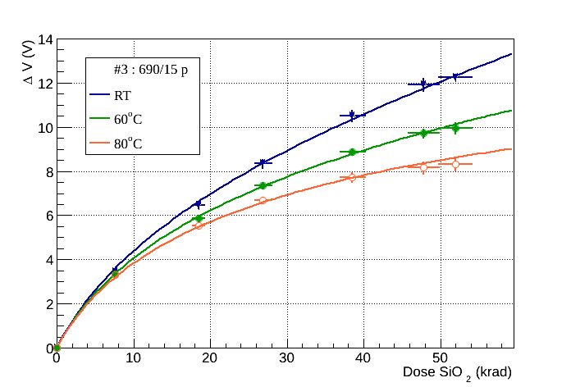
LDR irradiation
Up to 52 krad (SiO2) for γ = 0.0324 krad(SiO2)/h ~ 67 days
RF0
RF2
RF1
RF3

Slide 11
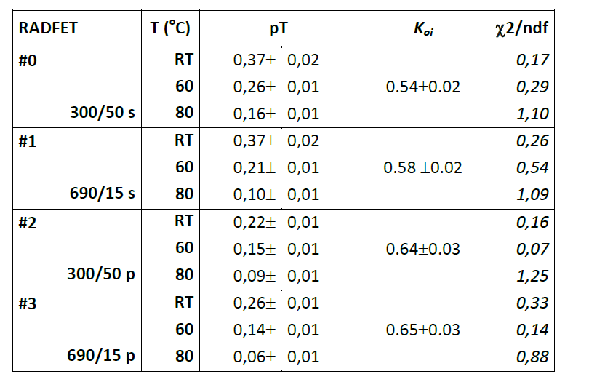
LDR irradiation free fit parameters

Slide 12
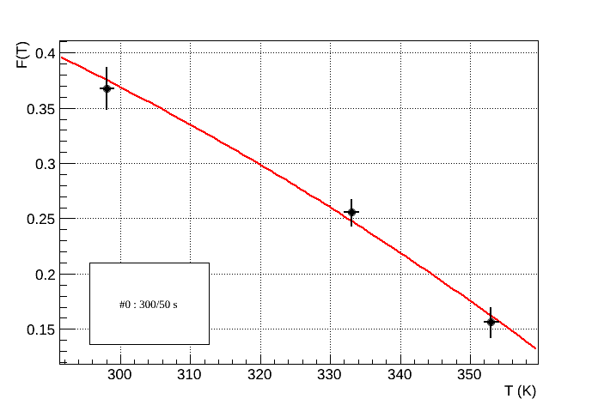
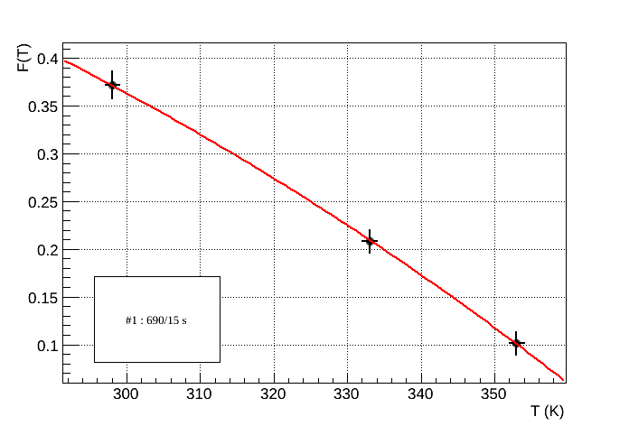
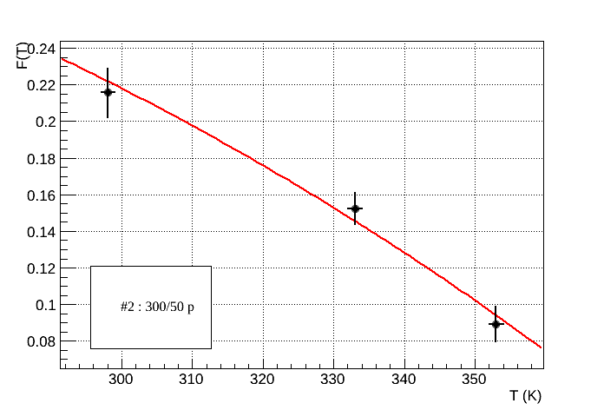
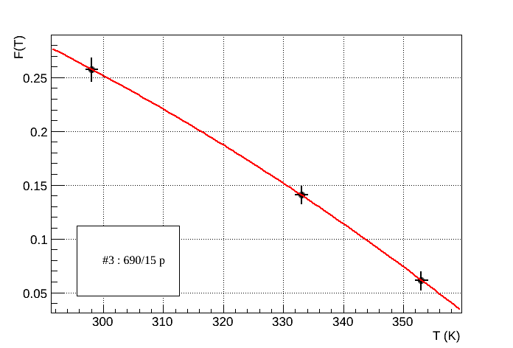
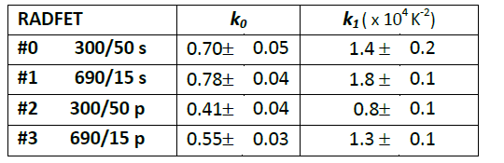
Temperature dependence
RF0
RF2
RF1
RF3
With E_{t,max}=0.65 eV

Slide 13
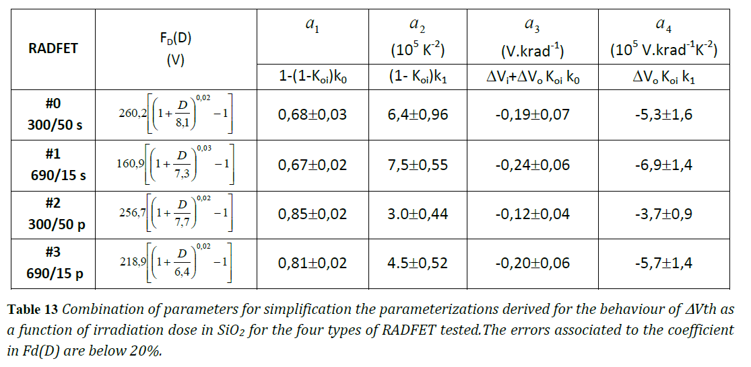
RADFET Calibration

Slide 14
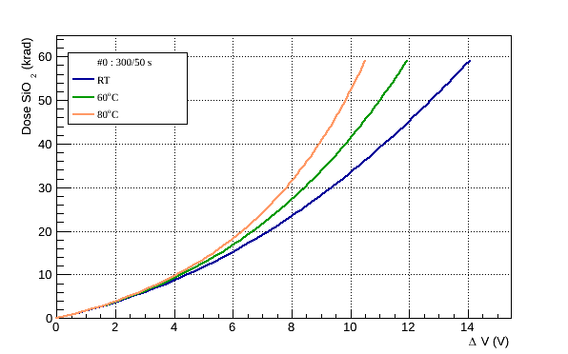
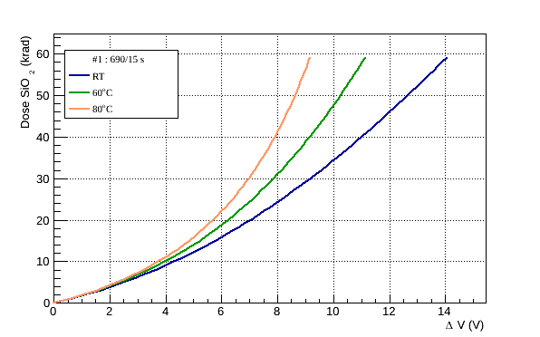
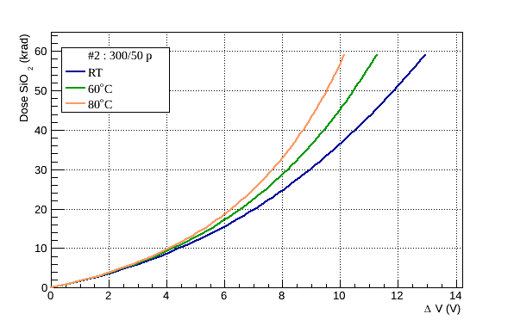
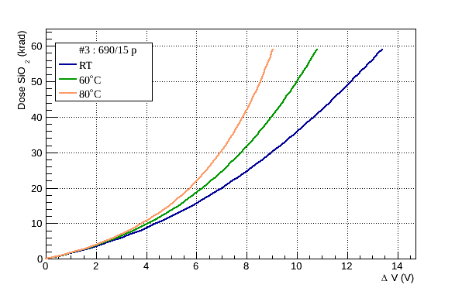
Dose vs ΔV_{th} calibration curves
RF0
The response of RFs 300/50 s and p is slighlty less dependent on the temperature than RFs 690/15 s and p.
RF2
RF1
RF3
Used in the CTTB

Slide 15
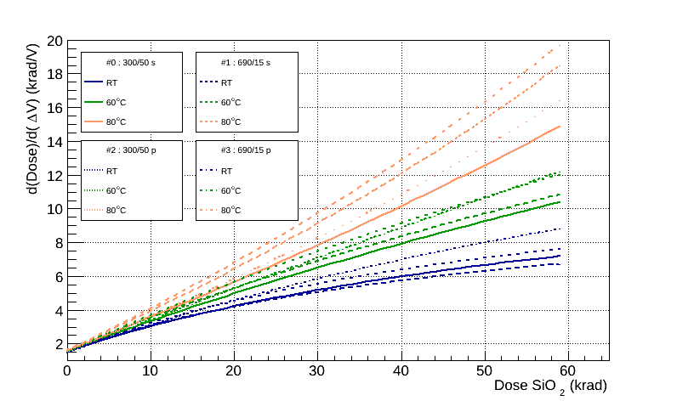
Used in the CTTB
RFs 300/50 have better performance (resolving power)
as T and Dose increase.

Slide 16
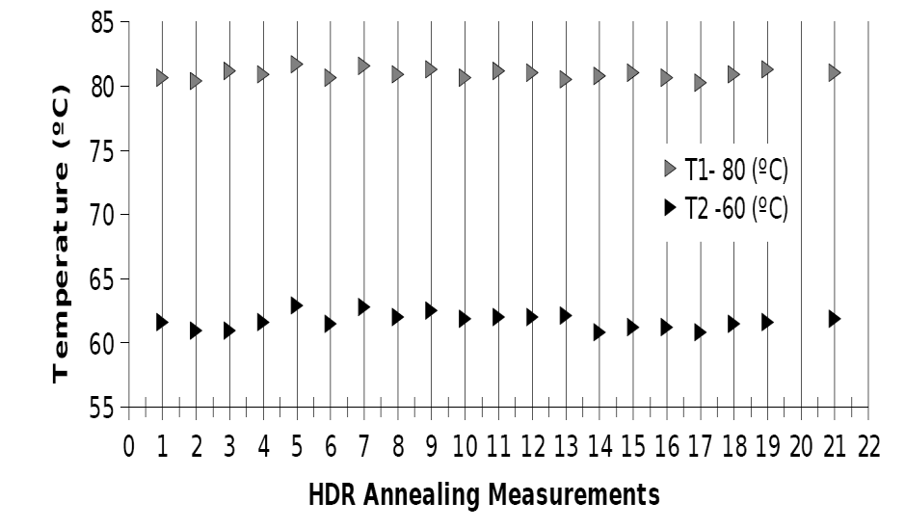
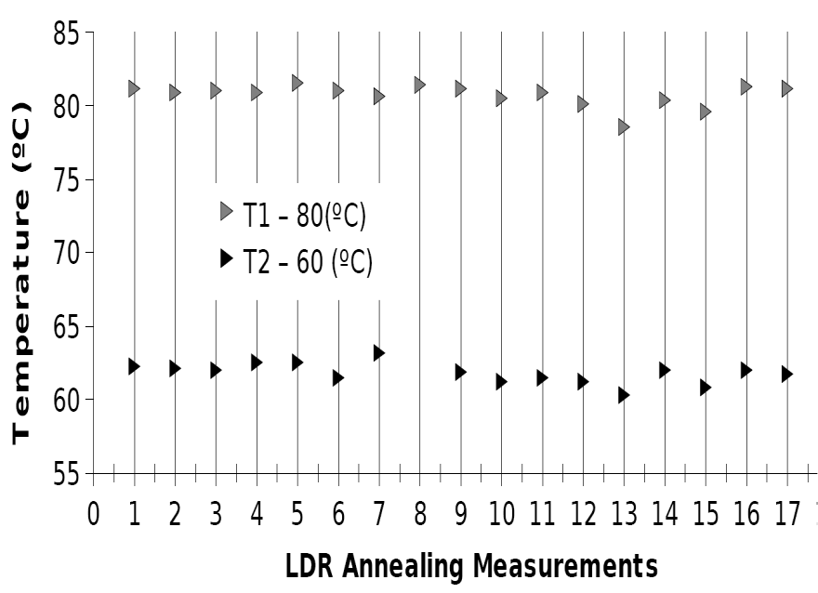
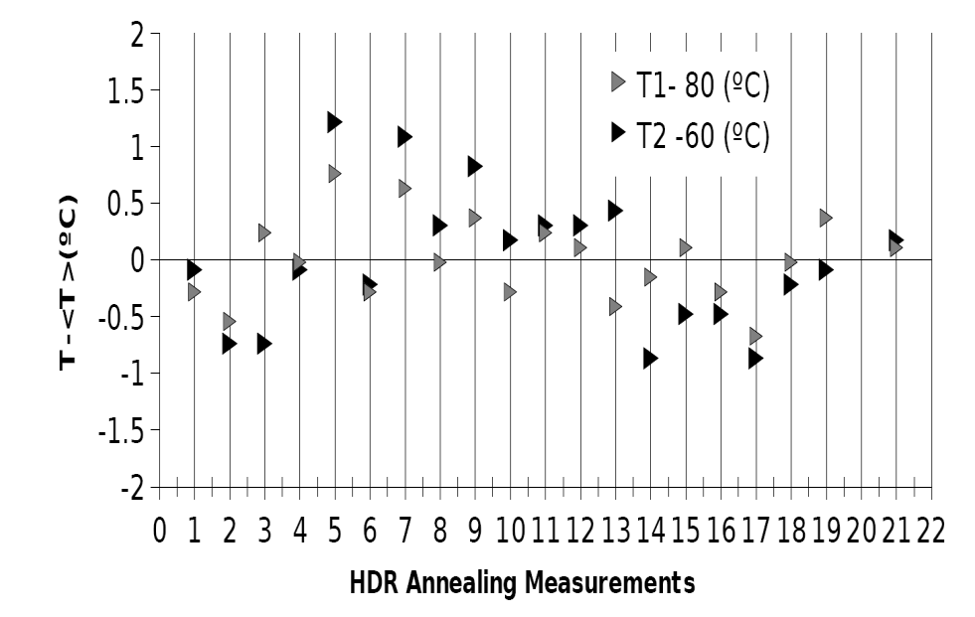
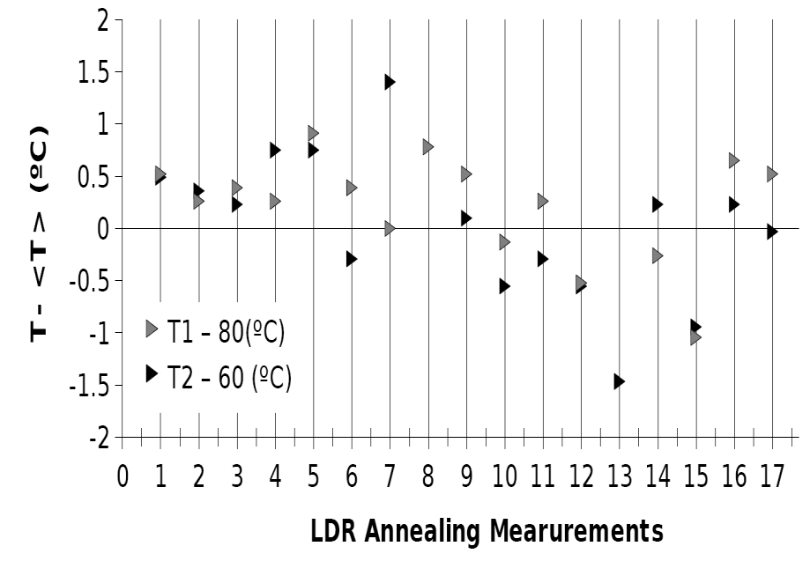
Annealing Temperature monitoring
Temperature logging data recorded in the heated RADFET boards, during the annealing phase of the RADFETs Difference between the measured temperature for each annealing point and the average value for the 20 available measurements, for the 60°C and 80°C sets .

Slide 17
Annealing
Fixed Trap density during isothermal annealing is given by the sum of the positively charged fixed trap (PCTFs) density and negatively charged fixed trap density (NCFT). (*)
4 free Parameters
(*) G. S. Ristic, N. Vasovic and A.Jaksic,”The fixed oxide trap modeling during isothermal and isochronal annealing of irradiated RADFETs”, J. Phys.D. : Appl. Phys. 45 (2012) 305101

Slide 18
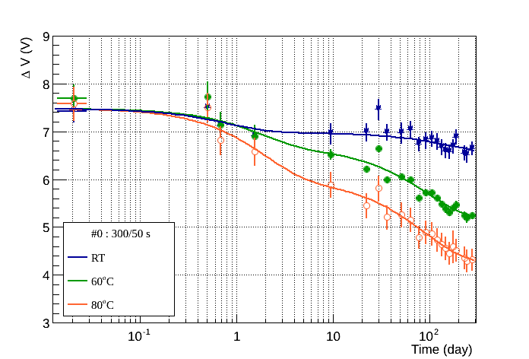
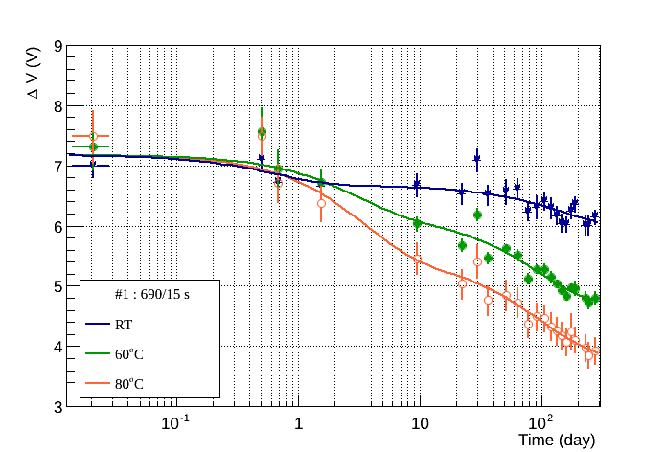
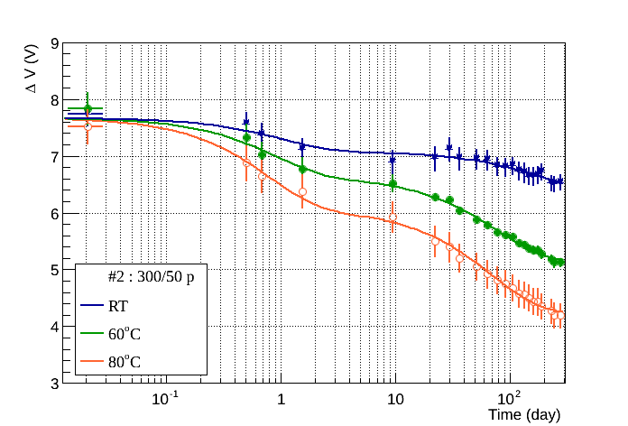
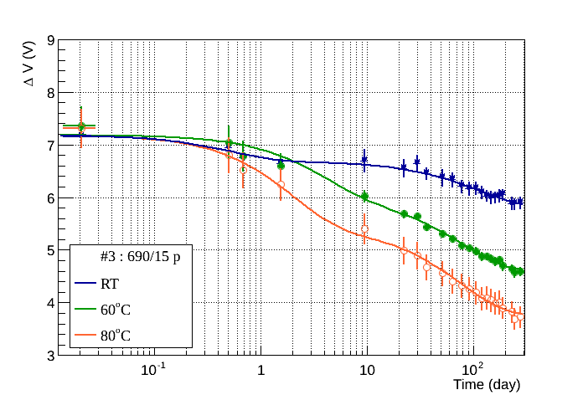
Annealing
HDR irradiated (271 days)
RF0
RF2
RF1
RF3

Slide 19
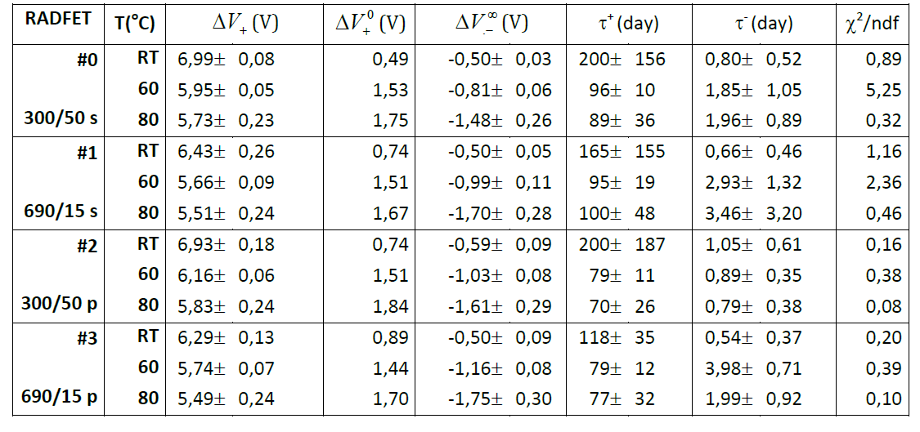
Annealing
HDR irradiated

Slide 20
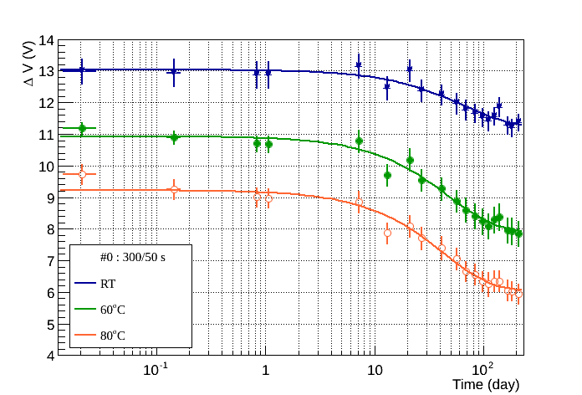
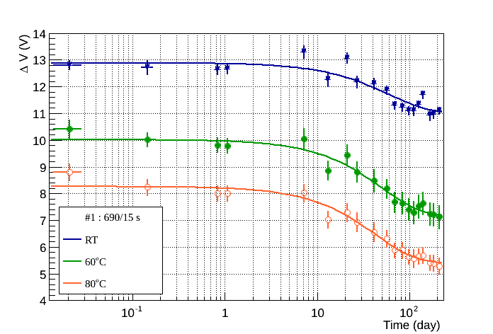
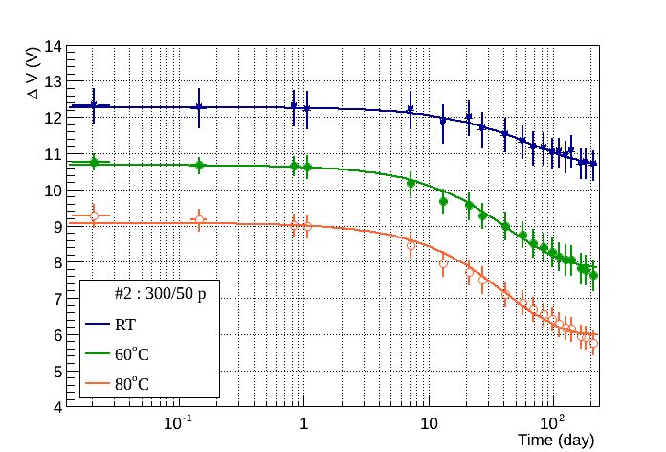
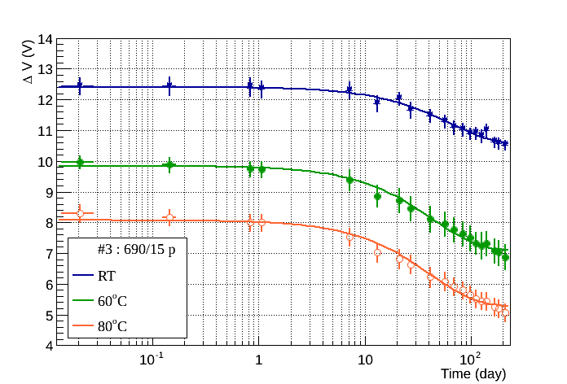
Annealing
LDR irradiated (211 days)
RF0
RF2
RF1
RF3

Slide 21
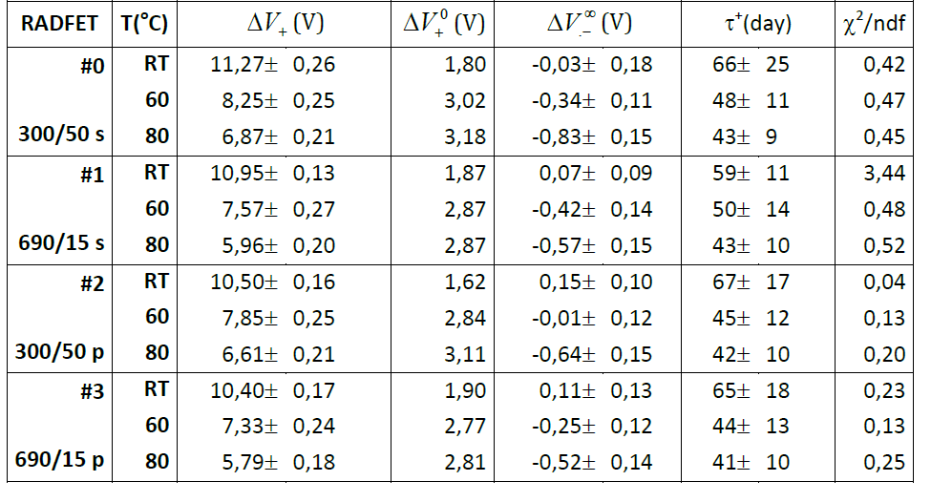
Annealing
LDR irradiated

Slide 22
Lessons learned
More measurements at different accumulated Dose values should be performed during the irradiation campaign
More measurements of Dose vs. ΔV_{th} should be performed for Dose <20 krad.
More than 3 temperatures should be tested to constrain temperature dependency
More measurements should be performed during the first day of annealing of the RADFETs
Study the behavior of the RADFETs at T =90-100ºC and at temperatures T< 25ºC

