Slide 1
ESA CNES Final Presentation Days - 2013
RADEF status report
ESA/ESTEC Contract No. 18197/04/NL/CP:
“High Energy Heavy Ion Test Facility for Component Radiation Studies”
Arto Javanainen/
Ari Virtanen, JYFL

Slide 2
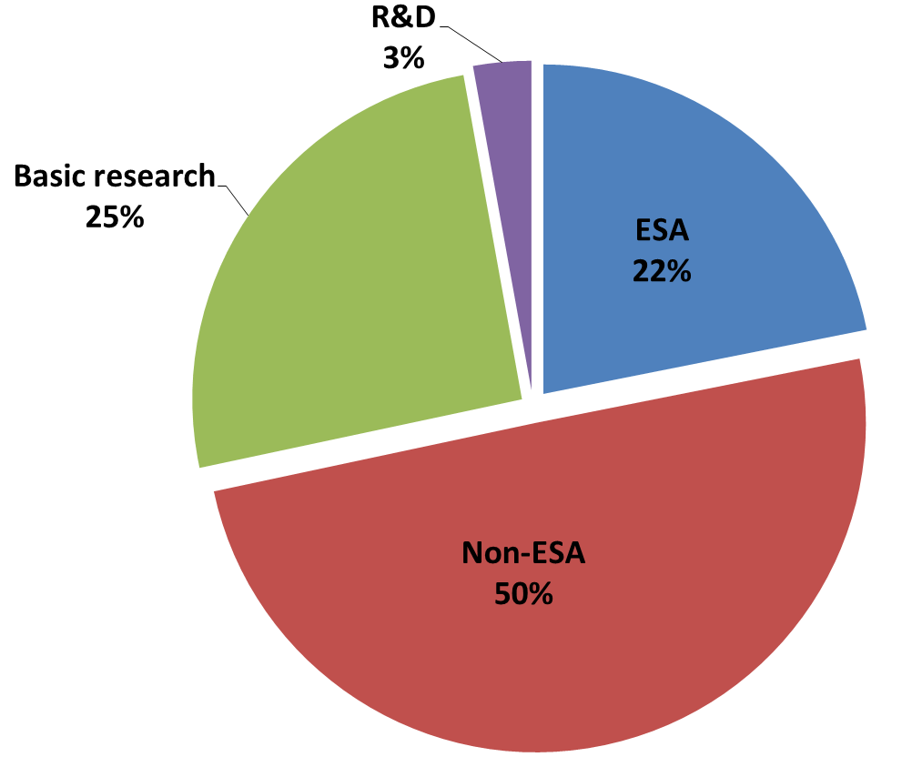
ESA CNES Final Presentation Days - 2013
Usage of beam time
2011
Total beam hours 1161
2012
Total beam hours 1208

Slide 3
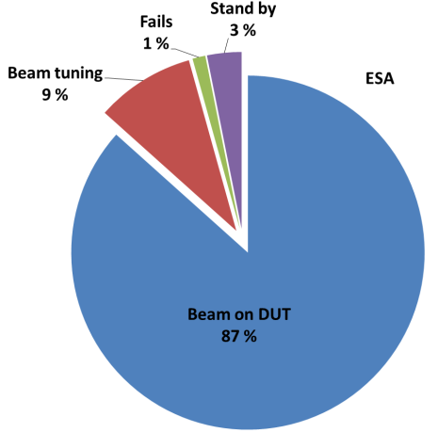
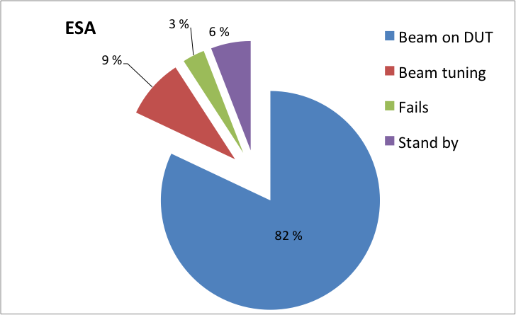
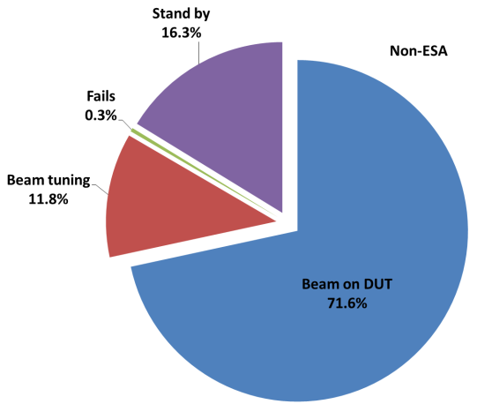
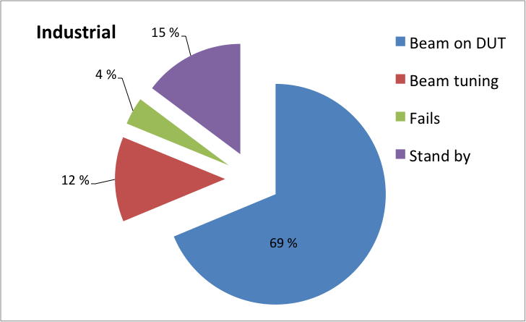
ESA CNES Final Presentation Days - 2013
Beam distributions with ESA- and non-ESA beam times
2011
2012
Non-ESA

Slide 4
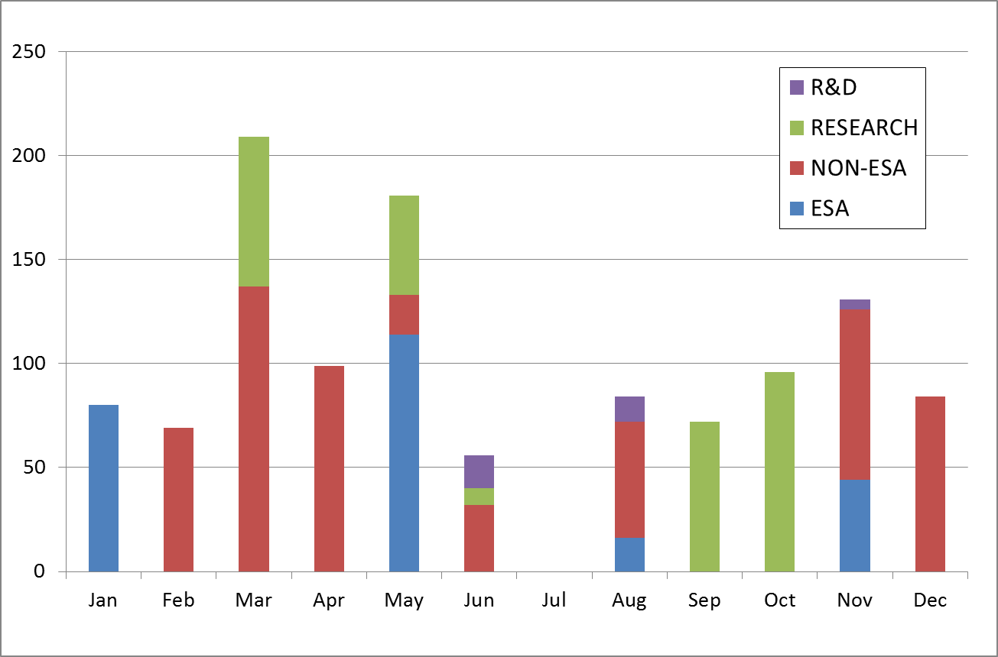
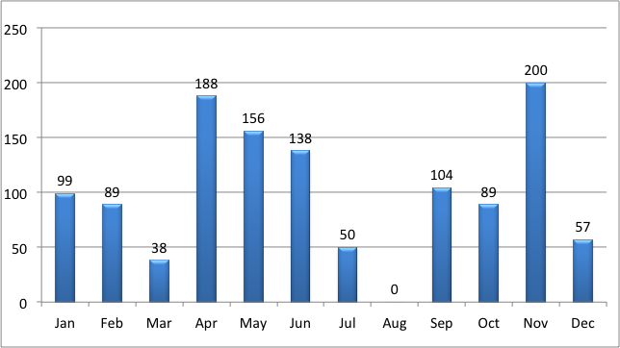
ESA CNES Final Presentation Days - 2013
Monthly distribution of beam hours
2011
2012

Slide 5
ESA CNES Final Presentation Days - 2013
Users
2011
2012
DTU, Denmark
EADS ASTRIUM, France
EFACEC, Portugal
ESA/ESTEC, The Netherland
FUJI Electric, Japan
HIREX Engineering, France
IDA, Germany
JAXA, Japan
NASA/JPL, CA, USA
RUAG Sweden
SOFRADIR, France
Thales Alenia Space, France
TRAD, France
ATMEL, France
DLR, German Aerospace Center
EADS ASTRIUM, France
ESA/ESTEC, The Netherlands
HIREX Engineering, France
IDA, Institute of Computer and Network Engineering, Germany
IMEC, Interuniversity Microelectronics Centre, Belgium
Microtest, Italy
RUAG Sweden
Sandia National Laboratories, NM, USA
Thales Alenia Space, France
TRAD, France

Slide 6
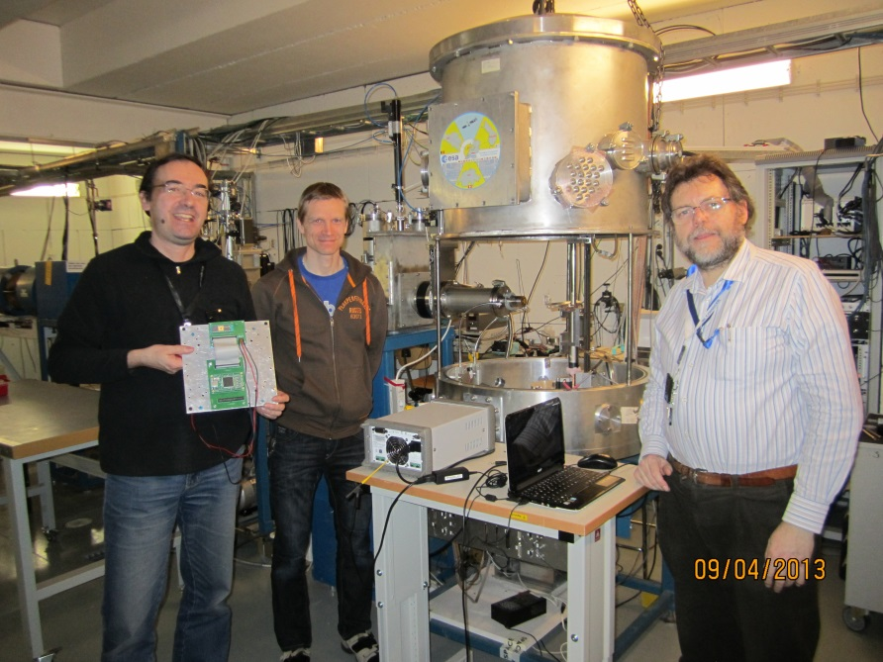
ESA CNES Final Presentation Days - 2013
Other contributions
SkyFlash (262890 EU-FP7 Project), started in 2011
It aims to develop a RadHard by design (RHBD) methodology for non-volatile flash memories.
Other partners are from Cyprus, Israel, Italy, Spain and Sweden
Two heavy ion tests has been performed so far
In April 2013 Dr. Cristiano Calligaro (RedCat Devices) and prof. Valentino Liberali (Univ. of Milan) were testing at RADEF
… and gave also a dissemination seminar for the laboratory staff and graduate students

Slide 7
ESA CNES Final Presentation Days - 2013
Other contributions
Group members acted as reviewers in NSREC and RADECS
Arto Javanainen, Heikki Kettunen and Ari Virtanen
AV was a chair of dosimetry session in NSREC’12
AJ authored a paper presented in RADECS’12 (IEEE-TNS)
A collaboration with the University of Montpellier was started
Alexandre Bosser serves as an internship student for six months
… and starts his PhD thesis ”on ground effects” in autumn 2013
Also Sandia and ESA are interested in low-E protons/muons

Slide 8
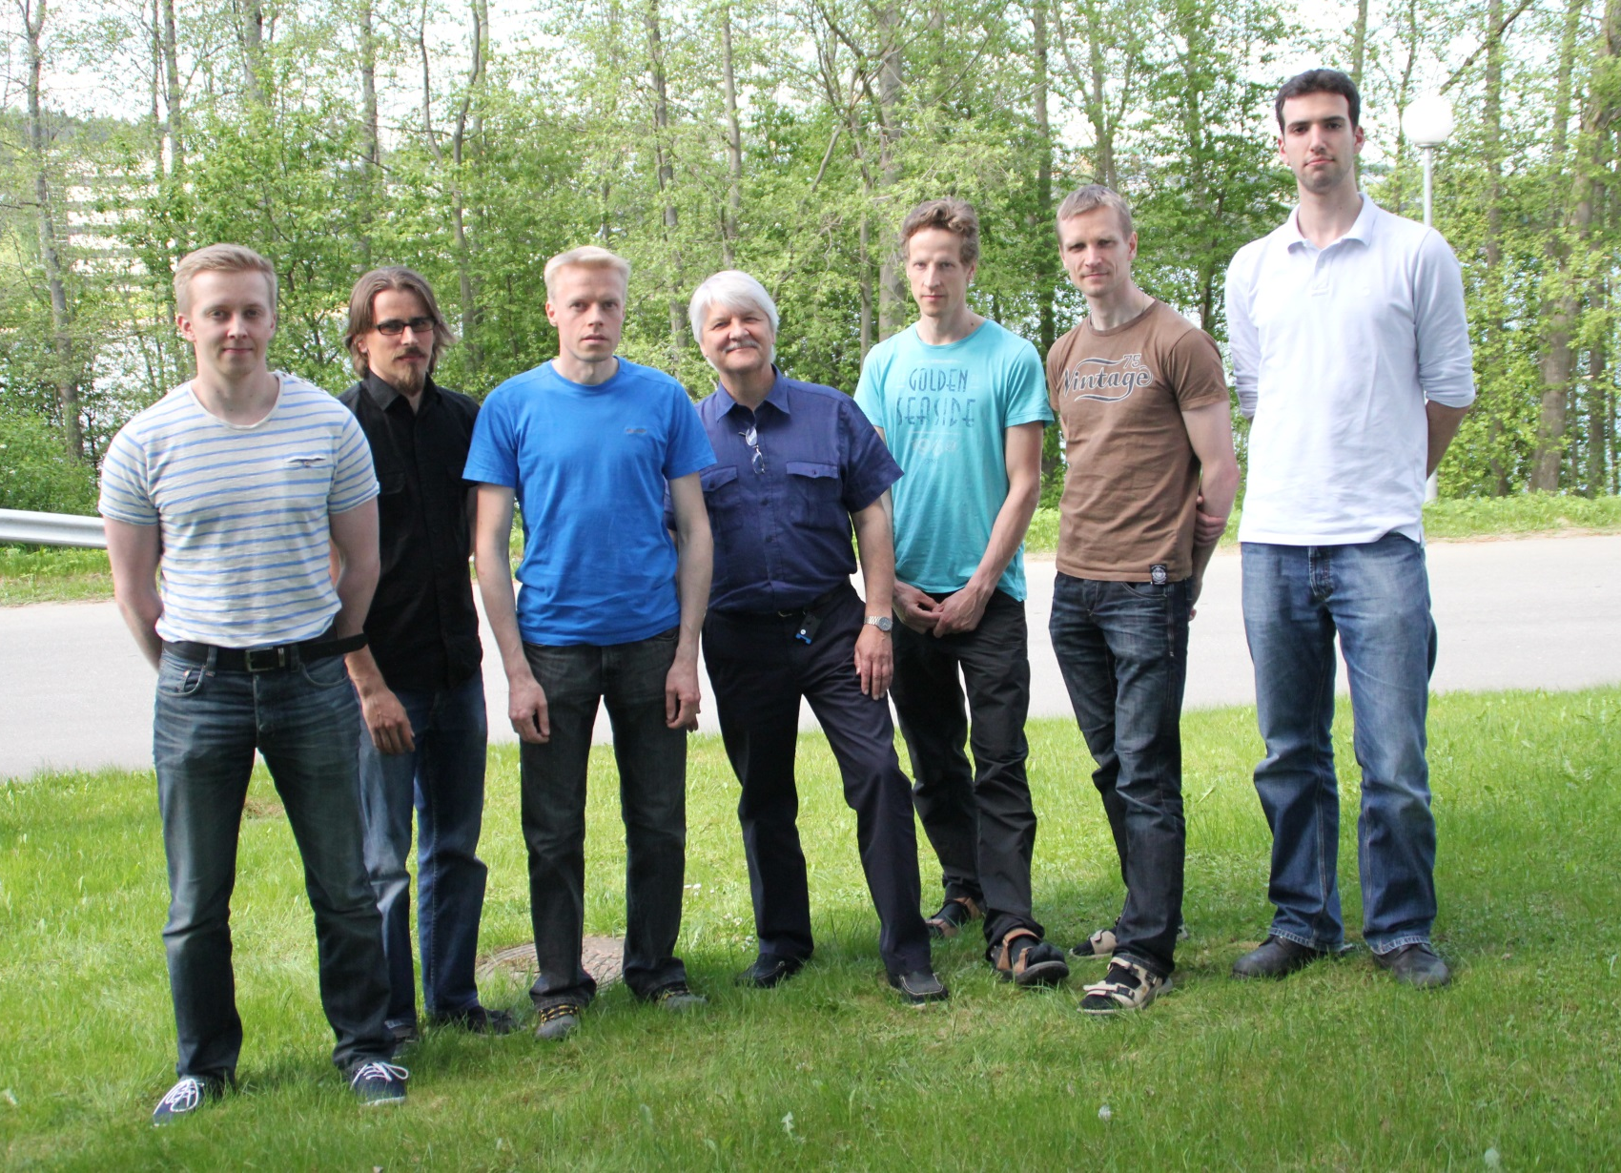
ESA CNES Final Presentation Days - 2013
Group photo taken in May 20th, 2013
Group photo
Arto
Alex
Heikki
Ari
Taneli
Jukka
Mikko

Slide 9
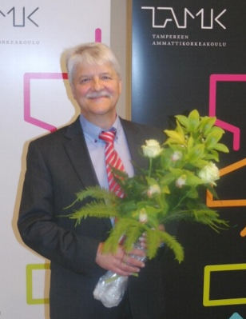
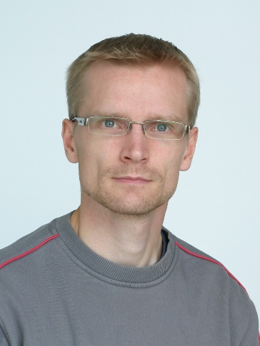
ESA CNES Final Presentation Days - 2013
RADEF highlights
First prize in the Academic Entrepreneurship Competition 2011 for Finnish universities
From research to business -concept
Among 13 universities
10 000 €
Arto Javanainen’s PhD work was approved with honors in 2012
His thesis was titled ”Particle radiation in microelectronics”
Arto has authored 5 and co-authored 6 peer-reviewed publications
For these reasons he received the 2013 Paul Phelps Continuing Education Grant, which will awarded to him in NSREC’13
the basis for judging was exceptional work as a graduate student in the fields of the NPSS.

Slide 10
ESA CNES Final Presentation Days - 2013
Group’s publications for 2011 - 2012
T. Siiskonen, H. Kettunen, K. Peräjärvi, A. Javanainen, M. Rossi, W. H. Trzaska, J. Turunen and A. Virtanen,
Energy loss measurement of protons in liquid water,
Phys. Med. Biol. 56 (2011) 2367-2374
F. Irom, D. N. Nguyen, R. Harboe-Sørensen and A. Virtanen,
Evaluation of Mechanisms in TID Degradation and SEE Susceptibility of Single- and Multi-Level High Density NAND Flash Memories,
IEEE Trans. Nucl. Sci., Vol. 58, No. 5(2) (2011) pp. 2477 - 2482
T. Kalvas, O. Tarvainen, H. Clark, J. Brinkley and J. Ärje,
Application of 3D Code IBSimu for Designing an H−/D− Extraction System for the Texas A&M Facility Upgrade
AIP Conf. Proc. 1390, pp. 439-448 (2011)
Rattanaporn Norarat, Timo Sajavaara, Mikko Laitinen, Pauli Heikkinen, Kimmo Ranttila, Kari Ylikorkala, Väinö Hänninen, Mikko Rossi, Pete Jones, Varpu Marjomäki, Leona Gilbert, Harry J. Whitlow,
Development of the Jyväskylä microbeam facility,
Nucl. Instr. Meth. B vol. 272, pp.158—161 (2011)
Arto Javanainen
Simple expression for electronic stopping force of heavy ions in solids
Nucl. Inst. Meth. In Phys. Res. B., 285, 159-161, 2012
S. Buchner, N. Roche, J. Warner, D. McMorrow, F. Miller, S. Morand, V. Pouget, C. Larue, V. Ferlet-Cavrois, F. El Mamouni, H. Kettunen, P. Adell, G. Allen, D. Aveline, Comparison of Single Event Transients Generated at Four Pulsed-Laser Test Facilities-NRL, IMS, EADS, JPL,Nuclear Science,
IEEE Transactions on , vol.59, no.4, pp.988-998, Aug. 2012
V. Ferlet-Cavrois, J. R. Schwank, S. Liu, M. Muschitiello, T. Beutier, A. Javanainen, A. Hedlund, C. Poivey, A. Mohammadzadeh, R. Harboe-Sorensen, G. Santin, B. Nickson, A. Menicucci, C. Binois, D. Peyre, S. K. Hoeffgen, S. Metzger, D. Schardt, H. Kettunen, A. Virtanen, G. Berger, B. Piquet, J.-C. Foy, M. Zafrani, P. Truscott, M. Poizat, F. Bezerra,
  Influence of Beam Conditions and Energy for SEE Testing,
  Nuclear Science, IEEE Transactions on , vol.59, no.4, pp.1149-1160, Aug. 2012
V. Ferlet-Cavrois, C. Binois, A. Carvalho, N. Ikeda, M. Inoue, B. Eisener, S. Gamerith, G. Chaumont, F. Pintacuda, A. Javanainen, J. R. Schwank, M. R. Shaneyfelt, J.-M. Lauenstein, R. L. Ladbury, M. Muschitiello, C. Poivey, A. Mohammadzadeh,
Statistical Analysis of Heavy-Ion Induced Gate Rupture in Power MOSFETs—Methodology for Radiation Hardness Assurance,
Nuclear Science, IEEE Transactions on , vol.59, no.6, pp.2920-2929, Dec. 2012
T. Kalvas, R. F. Welton, O. Tarvainen, B. X. Han and M. P. Stockli
Simulation of H$^-$ ion source extraction systems for the Spallation Neutron Source with Ion Beam Simulator
Rev. Sci. Instrum. 83, 02A705, 2012.
O. Midttun, T. Kalvas, M. Kronberger, J. Lettry, H. Pereira, C. Schmitzer and R. Scrivens
A new extraction system for the Linac4 H- ion source
Rev. Sci. Instrum. 83, 02B710, 2012.
J. Lettry, J. Alessi, D. Faircloth, A. Gerardin, T. Kalvas, H. Pereira and S. Sgobba
Investigation of ISIS and Brookhaven National Laboratory ion source electrodes after extended operation
Rev. Sci. Instrum. 83, 02A728, 2012.
B. X. Han, T. Kalvas, O. Tarvainen, R. F. Welton, S. N. Murray, T. R. Pennisi, M. Santana and M. P. Stockli
Low-energy beam transport studies supporting the spallation neutron source 1-MW beam operation
Rev. Sci. Instrum. 83, 02B727, 2012.
J. Lettry, U. Fantz, M. Kronberger, T. Kalvas, H. Koivisto, J. Komppula, E. Mahner, C. Schmitzer, J. Sanchez, R. Scrivens, O. Midttun, P. Myllyperkiö, M. O'Neil, H. Pereira, M. Paoluzzi, O. Tarvainen and D. Wünderlich
Optical emission spectroscopy of the Linac4 and superconducting proton Linac plasma generators
Rev. Sci. Instrum. 83, 02A729, 2012.

Slide 11
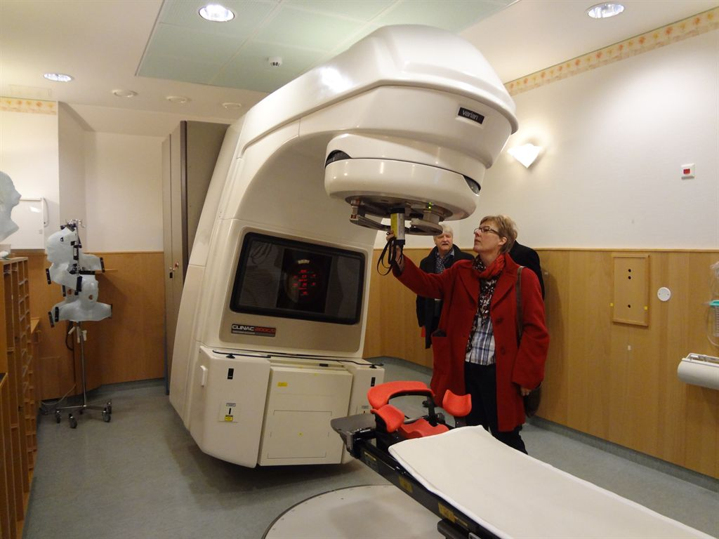
ESA CNES Final Presentation Days - 2013
Coming upgrades: A new electron accelerator
Our aim is to install Varian Clinac 2100CD radiation therapy accelerator in the RADEF cave
It can provide intense electron and x-ray beams up to 20 MeV and 15 MeV, respectively
It expands the selection of radiation from heavy-ion and proton beams available at RADEF
Among irradiation studies we foresee the large-scale satellite mission of ESA, JUICE = Jupiter Icy moon Explorer

Slide 12
ESA CNES Final Presentation Days - 2013
Coming upgrades: A new ECRIS
The objective is to improve the ECRIS (Electron Cyclotron Resonance Ion Source) capability to produce more intense and energetic ion beams. The special objective is to develop a new high-energy ion cocktail to be used at RADEF with the following properties:
increase the highest LET-value to 80 MeV/(mg/cm²) in silicon
extend the lowest Bragg Peak location close to 100 µm in silicon
This helps the European radiation effects community to be more competitive compared to the US facilities, because of:
the extended needs of higher LET and range values
the possibility to test at large tilt incidence or in air for example in the case of complex structures and modern nano-scale components with multiple connections
the need of long ion ranges for back-side irradiations when testing flip-chip components (for example all DDR2-DDR3 memories). Long range beams make the preparation of components easier (and with a better yield) by reducing the substrate thinning
A challenge could be to get as close as possible to the 15 MeV/nucleon cocktail, used at TAMU, where the heaviest ion is Au with a surface LET of 80 MeV/(mg/cm²) and the Bragg peak at 108 µm.

Slide 13
ESA CNES Final Presentation Days - 2013
But some things never change!
THANKS
AND
WELCOME TO RADEF

