Slide 1

Radiation Tests of Candidate Memory Devices
DDR3 SDRAM and NAND Flash
Martin Herrmann, Kai Grürmann, Fritz Gliem, Hagen Schmidt
ESTEC Technical Officer: Véronique Ferlet-Cavrois (TEC-QEC)
Institut für Datentechnik, TU Braunschweig

Slide 2
Overview
Part 1: DDR3 SDRAM (M. Herrmann)
  Test bed
  SEE tests
    SEL
    Software conditioning
    Hard SEUs
    Hard SEU annealing
  TID tests
    Band error pattern
    Error density
    Temperature dependence
    Annealing
    Idle current
Part 2: NAND Flash (K. Grürmann)

Slide 3
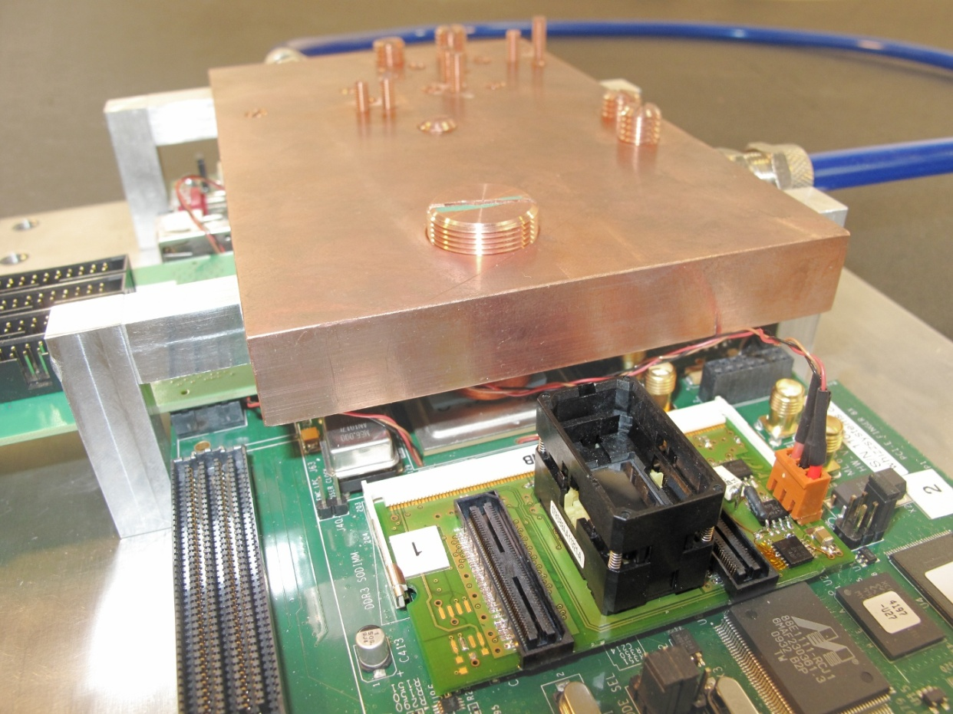
Test bed – head station (SEE)
FPGA
(Xilinx Virtex6)
Water cooler
DDR3 device
(opened)
Power switching
Custom
SODIMM
ZIF socket

Slide 4
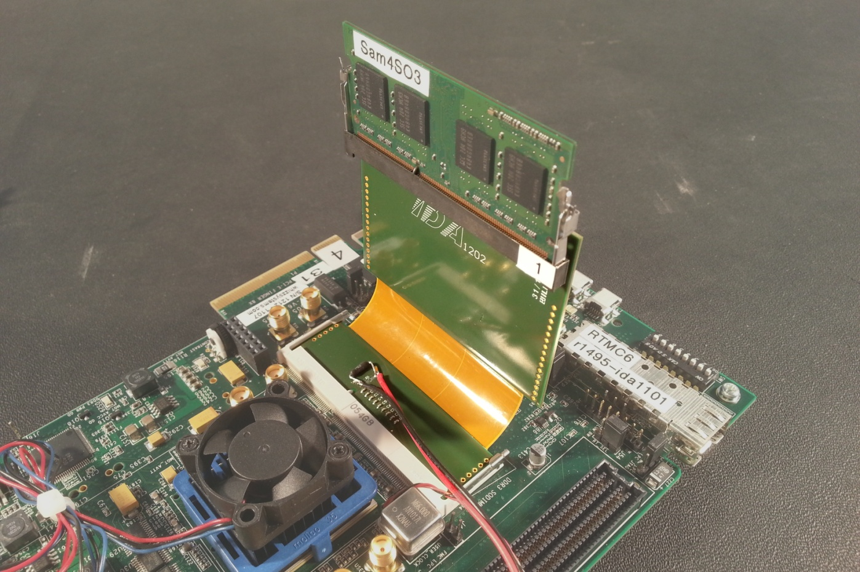
Test bed – head station (TID)
SODIMM
FPGA
(Xilinx Virtex6)
Flexible
extension

Slide 5
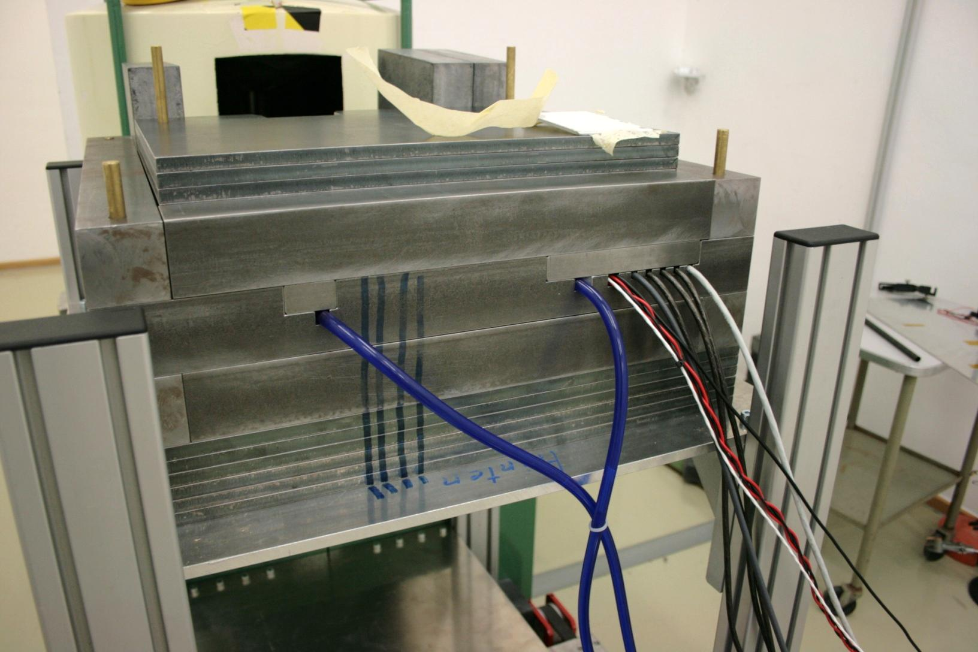
Test bed – shielding

Slide 6
SEE tests
Campaigns:
  3 × RADEF, Jyväskylä
  1 × TAMU, College Station, Texas
Parts:
  2 Gbit: Samsung, Hynix, Micron, Nanya
  4 Gbit: Samsung, Hynix, Elpida

Slide 7
SEE results – SEL
Setup:
  4 Gbit, Samsung and Hynix, thinned to 200 µm
  80 °C
  10⁷ cm⁻² Xenon @ 61.1
  Write/read mode
Result:
  No SEL
  Current returns to original value after irradiation

Slide 8
SEE results – software conditioning
Elpida: reduces device SEFIs
Samsung: no effect

Slide 9
SEE results – hard SEU share
Hard SEUs: can not be removed by rewriting

Slide 10
SEE results – hard SEU annealing
Vacuum
Room temperature

Slide 11
TID campaigns
Campaigns:
  2 × ESTEC, Noordwijk
Parts:
  In-Situ, 4 Gbit: Samsung
  Unbiased, 4 Gbit: Samsung, Hynix, Elpida
  Unbiased, 2 Gbit: Samsung, Hynix, Micron, Nanya

Slide 12
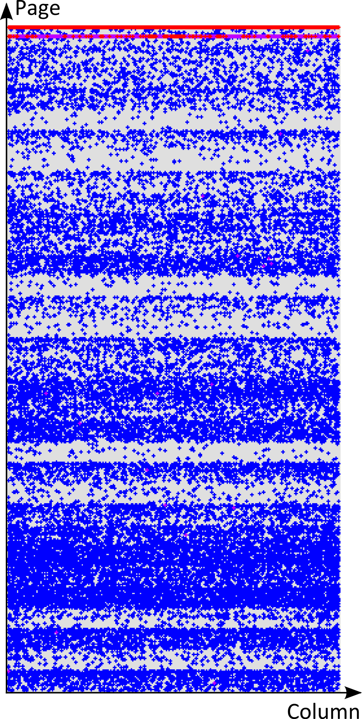
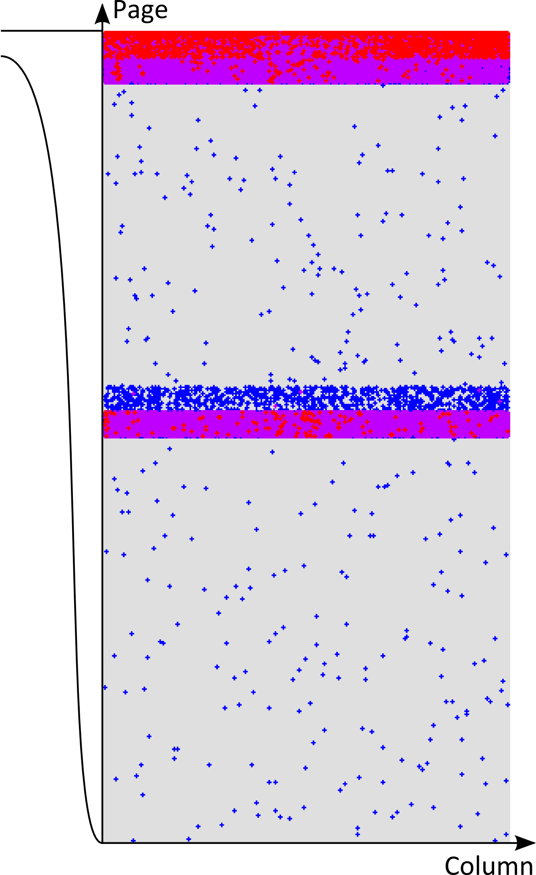
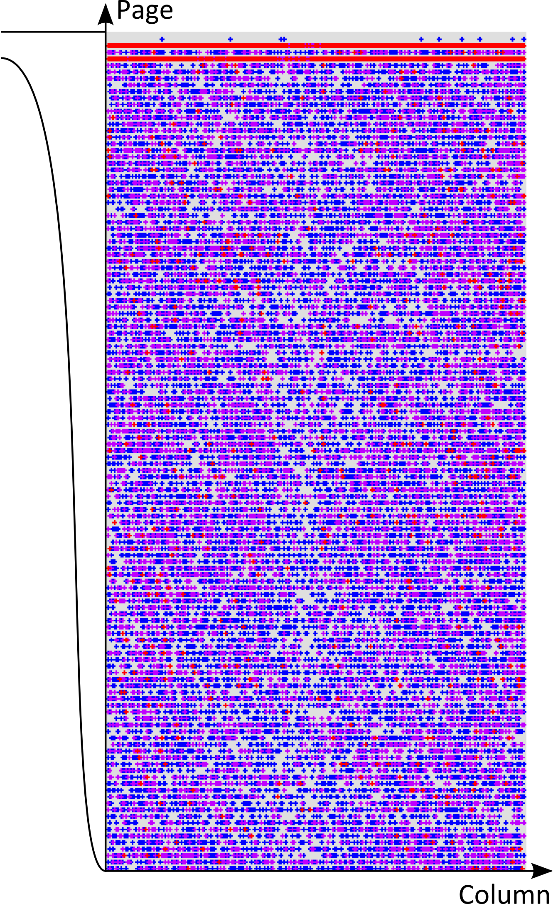
TID – band error pattern
DRAM: organized in pages

Slide 13
TID results – error density

Slide 14
TID results – temperature dependence

Slide 15
TID results – annealing

Slide 16
TID results – idle current

Slide 17
Summary
SEE results
TID results
No SEL (LET=60, normal incidence)
Software conditioning may reduce SEFI sensitivity
≈10% hard SEUs
Significant hard SEU annealing
D ≥ 150 krad: Band error pattern – triggered by page activation?
D = 300 krad: error density < 10⁻⁶
Strong temperature dependence
Significant annealing
Slight idle current increase
Future work
Band error pattern – further examination
Tests at higher temperature – 50°C? 80°C? Realistic requirement?
SEL at 60° incidence
Detailed current measurement (SEFI/SEL)

Slide 18
Overview
Part 1: DDR3 SDRAM (M. Herrmann)
Part 2: NAND flash (K. Grürmann)
  Cross sections
    Static random SEU
    Transient SEFI
    Persistent SEFI
    Destructive failure
  Annealing
    Soft SEUs
    Hard SEUs
  MBUs

Slide 19
NAND-Flash Static Random SEU cross section
Stuck bits from previous runs subtracted from the error count
Low LET: several orders of magnitude between 25 nm and 50 nm generation
Threshold LET substantially lower than the lowest LET of RADEF cocktail
SEU results differ at low LET from the results presented by F. Irom, JPL

Slide 20
NAND-Flash Class B Transient SEFI cross section
Sum of row, column and block errors
Dominated by row errors
All row errors are transient

Slide 21
NAND-Flash Class C Persistent SEFI cross section
Sum of row, column and block errors
Dominated by column errors
All column errors are persistent
One out of 2000 xenon ions generates a Class C Persistent SEFI

Slide 22
NAND-Flash Destructive Failure (DF) cross section
Statistical nature as SEU and SEFI events
Erase or write operation no longer functional
Persistent rise (factor 4) of supply current during write operation
1 DF in 250 years in mass memory of 1000 devices @ 1 AU, GCR, Samsung 8-Gbit

Slide 23
NAND-Flash Annealing of Soft SEUs
Two effects: a) loss of the negative floating gate charge, irreversible
b) positive charge trapping near the floating gate, reversible with time, annealing

Slide 24
NAND-Flash Annealing with decreasing feature size
With feature size scaling, charge loss dominates over charge trapping
Trapped charge domain is restricted more and more to lower LET
Remarkably same parts with different lot codes differ substantially

Slide 25
NAND-Flash Annealing of Hard SEUs
Steady increase of hard SEUs percentage with LET
Significant annealing of soft SEUs only at nitrogen
In contrast to the soft SEUs, typically more than one half of the hard SEUs anneal within 20 days

Slide 26
NAND-Flash Annealing of Hard SEUs
Short term / long term Hard Error annealing
“Reverse annealing” process during first 20 minutes at xenon

Slide 27
NAND-Flash Annealing of Hard SEUs
Increase of the hard SEU count after repeated erase-write-read cycles

Slide 28
NAND-Flash Percentage of MBUs
In most cases corruption of the same bit in the same byte of adjacent rows
Multi bit errors (MBU) in the same byte are rare
Increase of the share of adjacent row SEUs with LET

Slide 29
NAND-Flash MBU consisting of Soft SEU and Hard SEU
MBUs at normal incidence, Xe, LET=60
Hard SEU in the center of the MBU

Slide 30
Summary
Addressed NAND-Flash topics
SEU
SEFI
Destructive failure
Annealing of soft and hard SEU
MBU at normal incidence

Slide 31
References
Recent publications
  M. Herrmann et al., “Heavy ion SEE test of 2 Gbit DDR3 SDRAM”, RADECS Data Workshop, DW-28, 2011
  K. Grürmann et al., “Heavy Ion sensitivity of 16/32-Gbit NAND-Flash and 4-Gbit DDR3 SDRAM”, IEEE NSREC Data Workshop, W-9, 2012
  M. Herrmann et al., “New SEE Test Results for 4 Gbit DDR3 SDRAM”,
  RADECS Data Workshop, DW-25L, 2012
  K. Grürmann et al., “New SEE Test Results of 16/32-Gbit SLC NAND-Flash”, RADECS Data Workshop, DW-23L, 2012
  S. Gerardin et al., “Radiation Effects in Flash Memories”, accepted for IEEE TNS Special Issue, 2013
  M. Herrmann at al., In-Situ TID Test of 4-Gbit DDR3 SDRAM Devices, submitted to NSREC Data Workshop, 2013
DDR3 SDRAM technical notes
  M. Herrmann et al., “TID Test of 4 Gbit DDR3 SDRAM Devices”, TN-IDA-RAD-13/4
  M. Herrmann et al., “Heavy Ion SEE Test of 4 Gbit DDR3 SDRAM Devices”, TN-IDA-RAD-13/1
  M. Herrmann et al., “Unbiased TID Test of 2-Gbit and 4-Gbit DDR3 SDRAM Devices”, TN-IDA-RAD-13/9
NAND Flash technical notes
  K. Grürmann et al., “Heavy Ion SEE Test of 2-Gbit DDR3 SDRAM Devices and of 8-Gbit NAND-Flash Memory Devices, RADEF Jyväskylä, May 23 – 27, 2011”, Test Report, TN-IDA-RAD-11/5B
  K. Grürmann et al., “Heavy Ion SEE Test of 16-Gbit/32-Gbit Micron SLC NAND-Flash Memory Devices, RADEF Jyväskylä, Jan. 9 – 13, 2012, RADEF Jyväskylä, April 16 – 20, 2012”, Test Report, TN-IDA-RAD-12/12
  K. Grürmann et al., “Heavy Ion SEE Test of 4 x 8-Gbit Samsung and 16-Gbit Micron SLC NAND-Flash Memory Devices, TAMU Texas, December 4 – 7, 2012”, Test Report, TN-IDA-RAD-13/2B

