Slide 1

ESA approach to project level verification of soldering assembly
G. Corocher (TEC-QTM)
Noordwijk 22/5/2014

Slide 2
ECSS-ST-Q-70-38-C
The introduction of ECSS-ST-Q-70-38C states:
“..The mounting and supporting of components, terminals and conductors
prescribed herein applies to assemblies designed to operate within the
temperature limits of ‐55 °C to +85 °C…”
“Verification of SMD assembly processes is made on test vehicles (surface
mount verification samples). Temperature cycling ensures the operational
lifetime for spacecraft. However, mechanical testing only indicates SMD
reliability as it is unlikely that the test vehicle represents every flight
configuration.”

Slide 3
Project level verification
As project level verification (of the soldering assembly) it is meant a verification tailored to meet the requirements (mechanical and thermal) of a specific mission.

Slide 4
When can it be applied?
In cases where ECSS-STQ-70-38C is applicable. The “general verification” environmental test conditions of paragraph 14 are applied.
In case :
Of failure during general verification
Mission conditions not enveloped by those covered by ECSS standard.
ECSS-Q70-38C not fully applicable (typically microgravity payloads and science instruments).
A project level verification approach can be considered.
Note: the procedure for Assembly verification (TEC-QT-2013/398/CV) applies also to project level verifications.

Slide 5
When can it be applied?

Slide 6
Test conditions….
Test conditions shall be defined on the basis of mission requirements:
Mechanical loads:
Vibration levels : project level qualification
3 axis
Duration recommended 5 minutes (as per ECSS)
Mechanical structure shall be representative of the application.
Schock test if applicable
Other mechanical loads depending on mission profile

Slide 7
Test conditions
Thermal cycling:
It is defined on the basis of the thermal conditions on the boards derived from the thermal analysis.
All the mission phases shall be considered including functional test and acceptance at board, unit and system level.
Nominal mission conditions shall be considered for the duration of the mission excluding unrealistic worse cases.

Slide 8
Test conditions
Calculation of the thermal cycling is performed applying the modified Coffin-Manson model with an additional time 2 margin on the result.
In case of parts verified by electrical monitoring (grid array devices) the margin is time 6.

Slide 9
Typical failures on critical devices
Project level verifications are often applied following failures in the frame of general verifications.
Project level verification are also considered as risk mitigation exercise run in parallel to the general verification. In this case it is normally focused to the “critical” devices identified in the ESA memo
TEC-QT-2012/206/CV

Slide 10
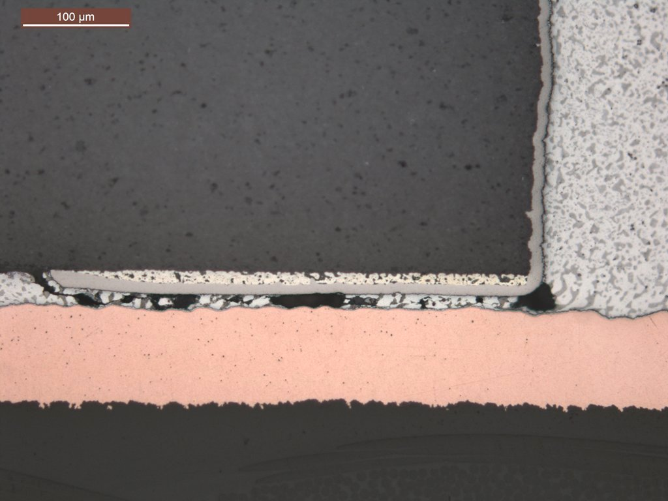
Chip Resistors
Device type: Chip resistors (R1206, R2010 R2512)
Type of failure: Cracks in solder joints

Slide 11
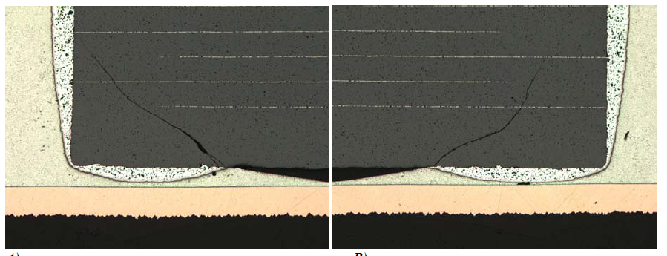
Ceramic chip capacitors
Device type: Chip capacitors
Type of failure: Cracks in the ceramic

Slide 12
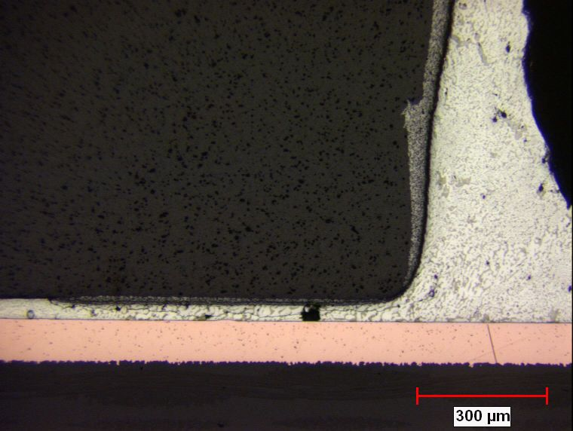
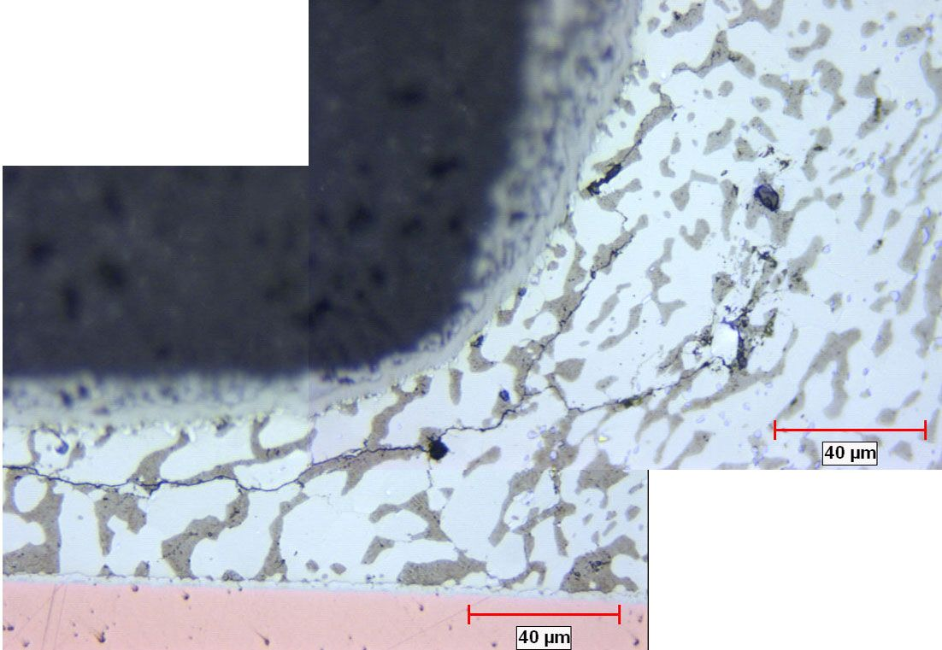
LCCs
Device type: LCCs, all sizes
Type of failure: Cracks in solder joints

Slide 13
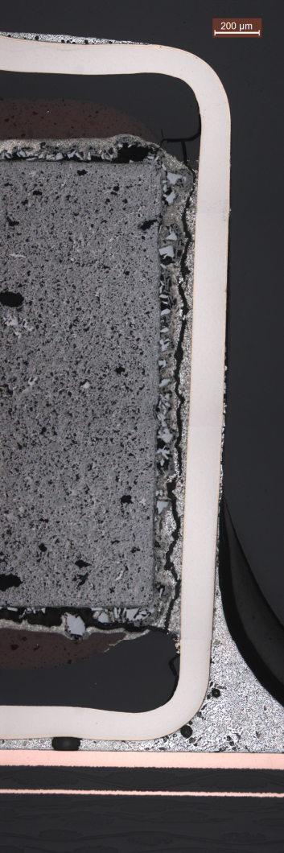
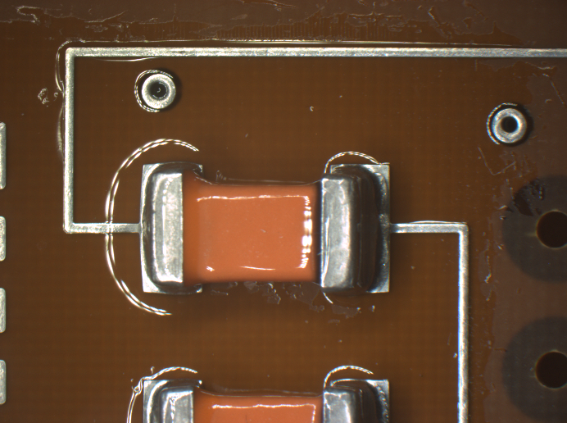
CWR 06
Device type: Tantalum capacitors CWR 06
Type of failure: Cracks in conductive adhesive in the device.

Slide 14
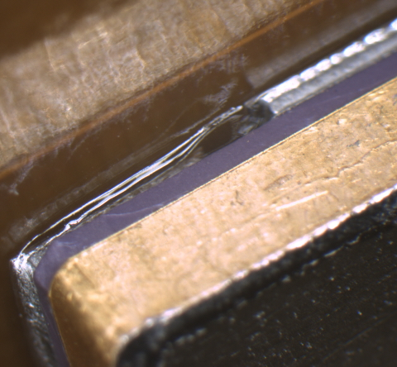
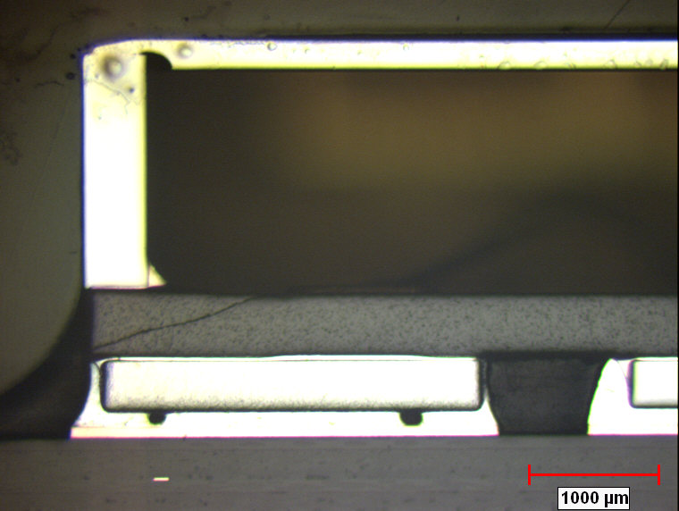
SMD 05, 1, 2,5
Device type: SMD05, SMD1 SMD2 SMD5 ..
Type of failure: Cracks in the ceramic package

Slide 15
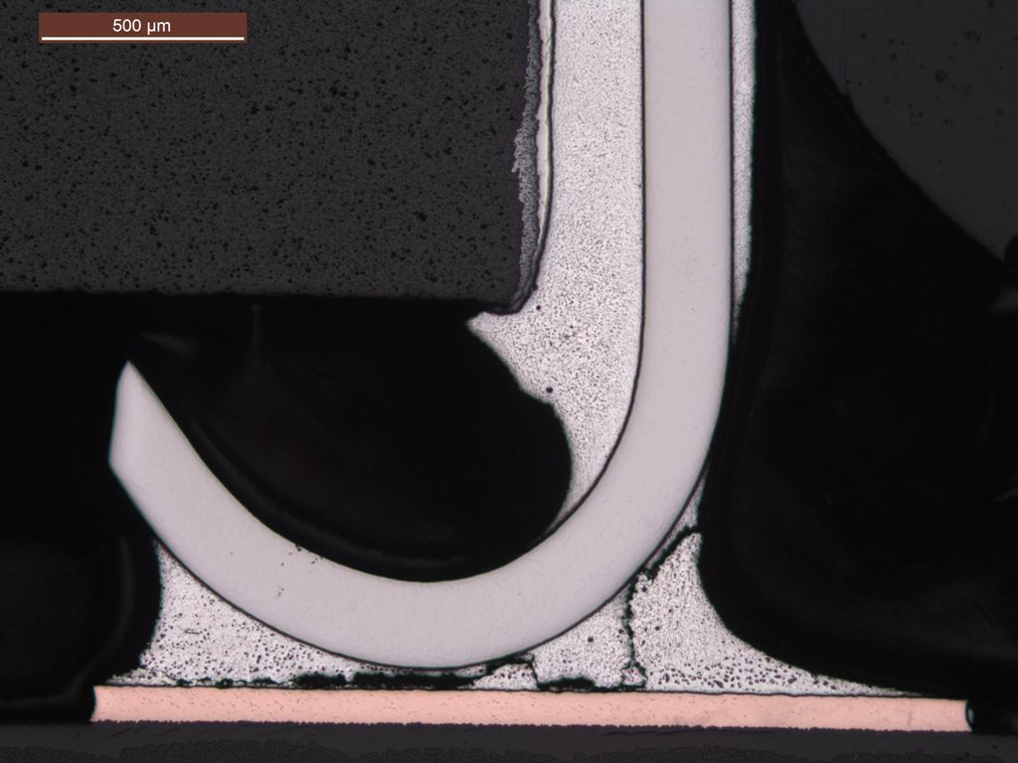
JLCC4
Device type: JLCC4
Type of failure: Cracks in the solder joint

Slide 16
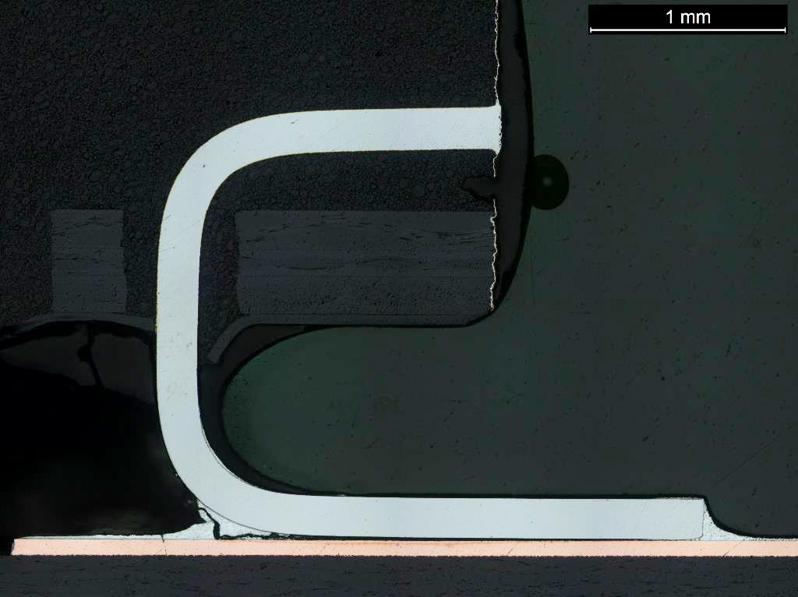
TSOP
Device type: TSOP all sizes
Type of failure: Cracks in the solder joint

Slide 17
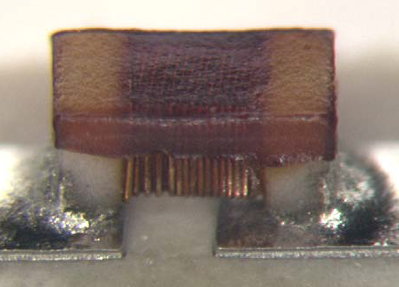
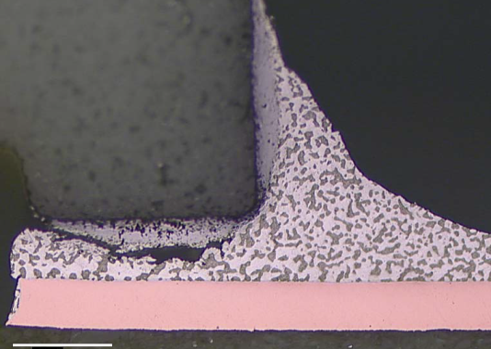
Inductors
Device type: inductors
Type of failure: poor wetting due to contamination from component manufacturing

Slide 18
Thank your for your attention
Any Question?

